Slide 1
Corruption in Uzbekistan: Political Context and Institutional Practice
David Lewis
“Raiding the Coffers, Violating Rights”: A Conference on Corruption and its Impact on Human Rights in the Post-Soviet World: A Challenge of Domestic and International Perspectives
Bern, Switzerland, 26-27 November 2014
Dr David Lewis, Department of Politics, University of Exeter (d.lewis@exeter.ac.uk)

Slide 2
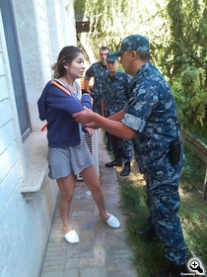
Corruption as a Political System
Corruption acts as the essential currency of informal system of power
Patron-client networks both produce loyalty and also sometimes threaten central control
Frequent ‘purges’ to reassert high-level control and prevent corrupt networks gaining autonomy in the system
  Purges of regional leaders, who develop local networks
  2010: arrests and detentions of business leaders,
    eg Dmitry Lim (Karavan Bazaar); Alik Nurutdinov (Bekabad cement); Zeromax closed
  2013-14: Closure of Karimova empire, Akbarali Abdullaev, + others

Slide 3
Corruption as an Institutional Challenge
Discretionary Powers
Opaque, complex legislation implemented in arbitrary ways by officials
Multiple government agencies involved in decisions
Complex system of licencing, taxation, currency exchange to operate business
State agencies (tax authorities, security services) subordinated to private interests
Constraints
Neutral state agencies involved in oversight functions
Courts and justice sector
Prokuratura
Independent media
Civil society organisations
International monitoring groups
Social and cultural attitudes
International restrictions on money-laundering, property and financial transactions
Financial Flows:
foreign investment;
public finance;
cross-border trade and financial flows

Slide 4
1. Foreign Investment
Multiple opportunities for corrupt practice in market entry and market maintenance strategies
Foreign investors face complex bureaucratic environment, and require government agency support for:
  Licences and government decrees in extractive sector
  Wide range of government agency permissions to operate
  Approval to purchase hard currency to buy inputs, repatriate profits
  Customs approval to import essential goods
Failure to conform to corrupt practice can lead to:
  suspension of licences (Oxus, Newmont, UzMetal etc);
  inspections by tax authorities and revocation of tax privileges
  raids by security services (German Bakery, etc.)
  effective expropriation through forced bankruptcy (multiple cases)
  Detention and prosecution of employees (Oxus, Tethys)

Slide 5
‘when there is no wrongdoing in Uzbekistan, the prosecutor’s office usually finds “miracle” tax violations, and this is reason enough to close a company and put an owner in prison’ Gulnara Karimova, 2013.

Slide 6

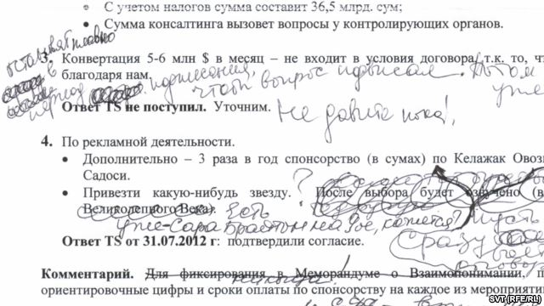
Case-study: TeliaSonera
  Market Entry: TeliaSonera paid over $300m to Takilant to receive telecoms licence
  Market Maintenance:
    Demands included $15m to provide 'accompaniment' through government agencies:
    Anti-Monopoly Committee;
    Foreign Ministry
    Tax Authority;
    Customs Committee;
    Uztelecom/the Communications and Information Agency of Uzbekistan.
  Teliasonera denied that it accepted this deal.

Slide 7
Case-Study: Metal-Tech
Metal-Tech (Israel) company invested in moybdenum mining in joint-venture;
  Market entry: received two government resolutions approving JV in 2000
  Hired three ‘consultants’, including brother of then prime minister Utkur Sultanov.
Market maintenance:
  at least two of the consultants had strong ties to serving government officials; internal documents say they were chosen to ‘facilitate closing red tapes’ [sic] in the country.
  Made payments totalling more than US$ 4m. into offshore accounts, an amount that “exceeded [Metal-Tech’s] initial cash contribution to the venture and amounted to nearly 20% of the entire project cost”.
Sultanov lost government position (Deputy PM) in April 2006; subsequently Metal-Tech faced harassment and bankruptcy

Slide 8
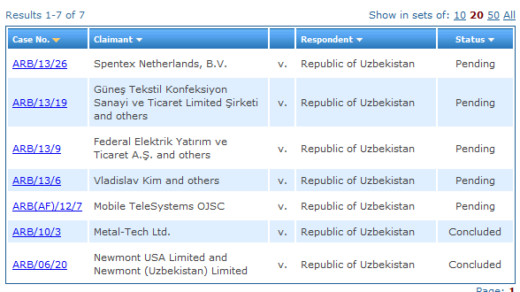
Arbitration Cases at International Centre for Settlement of Investment Disputes (ICSID)
(ICSID Case No. ARB/13/9)

Slide 9
Detention and prosecution of employees
Oxus Gold's chief metallurgist, Said Ashurov, was imprisoned on charges of espionage in 2011 and remained in prison in 2014. Senior Oxus staff fled the country after the arrest, fearing for their safety.
2011 eight employees of the Turkuaz retail group, including the director, were detained on charges of tax evasion. The director, Vahit Güneş, claimed that he was tortured while in detention. After over nine months in detention, they were released under an “amnesty “ in February 2012.
Five MTS managers were detained in July 2012, including Uzdonrobita General Director Radik Dautov, a Russian citizen, who was released in August and left the country. The four others went on trial on 27 August 2014.
In January 2012 several BekabadCement employees, including director general Sergey Nikitin, received long prison sentences and had their property and assets confiscated.
Bakhrom Salakhitdinov, head of Tethys operations in Uzbekistan, arrested in December 2013.

Slide 10
2. State and public finance
Kickbacks and tender fixing in state procurement
  No law on state procurement, but some recent reforms
  Tenders open to abuse, fixing in favour of selected applicants
Land use and leasing
    Frequent reports of human rights abuses against farmers, human rights defenders in this area
    In November 2013 the hokim of Shakhrisabz rayon, Qashqadaryo, was sentenced to 11 years in prison for corruption, including receiving over US$250,000 in bribes.
Budgetary fraud through phoney bankruptcies
  In 2009-2012 companies that went bankrupt owed the state budget ​​about 3,500bn Uzbek soms (US$1.47bn).
Extra-budgetary funds
  Opaque extra-budgetary funds with no public oversight
  Fund for Reconstruction and Development (FRD)
  Selkhozfond – repository for revenues from cotton

Slide 11
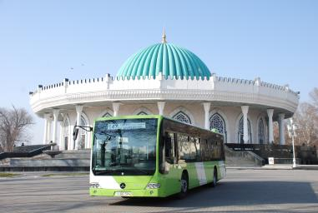
Kickbacks
In 2011 Daimler AG agreed with the US Department of Justice to pay US$93.6 million in criminal fines and penalties in relation to bribes paid to government officials in at least 22 countries
In Uzbekistan Daimler’s Evobus subsidiary
  paid approximately €3.5m in ‘improper payments’ to shell companies set up by government officials to secure a contract worth €37,415,070 to sell 302 buses and four vans to an Uzbek government agency.
  Used ‘phony consulting agreements’ with shell companies, funds paid to bank accounts in the UK and Switzerland held by companies registered in the British Virgin Islands

Slide 12
Tenders
Tenaris: global pipe supplier to oil and gas industries
2011 deal with US Department of Justice: Tenaris ‘admitted that its employees and agents offered and made improper payments to officials of OJSC O’ztashqineftgaz (OAO), an Uzbekistan state-controlled oil and gas production company’
Agent received 3-3.5% of contract worth to persuade tender officials to open bids illegally, and allow Tenaris to submit lower bid to win the tender
  “So dirty game is when . . . people from the [OAO] tender department ... can carefully open required bids and check the prices and deliveries of competitors and advise you where you need to be lower and where you need to be higher ... this dirty service is expensive .....”
    Department of Justice, 'Re: Tenaris', p. A2

Slide 13
3. Customs and cross-border
According to the World Bank, Uzbekistan is the worst country in the world for cross-border trade, achieving 189th place in the ‘Trading Across Borders’ index.
Widespread corruption encouraged by complex and punitive tariff system
  Multiple loopholes encourage traders to use bribery to cross border
  Corruption in some cases a way for local traders to cope with state closures of borders or high tariff regimes
Corrupt, high-tariff regime allows highly lucrative monopoly control of key trade sectors by well-connected companies
Arrests in 2014:
  In September 2014 a group of customs officials, headed by Colonel Sirojiddin Gulamov, head of the State Customs Committee for Tashkent region, was arrested and charged under Article 31 (‘receiving bribes’).
  accusations outlined typical vertical corruption structure in which, it was alleged, Gulamov headed a system which collected money from subordinates and appointed his own people to management posts. The figures involved were allegedly 'four or five-figure sums in US dollars''

Slide 14
Currency exchange
Access to hard currency highly restricted; in practice Uzbek sum is not freely convertible
Companies apply to NBU for official exchange, but can wait for more than a year to receive foreign currency (accounts frozen while they wait)
Access is determined by opaque procedures that provide some companies with preferential treatment: anecdotal evidence that corruption is rife throughout system
Companies appeal to their political patrons to achieve convertibility; some are forced to use the black market, which is unofficially regulated by the state (but is illegal)
Restricting access to foreign currency for foreign investors is a further way of applying pressure

Slide 15
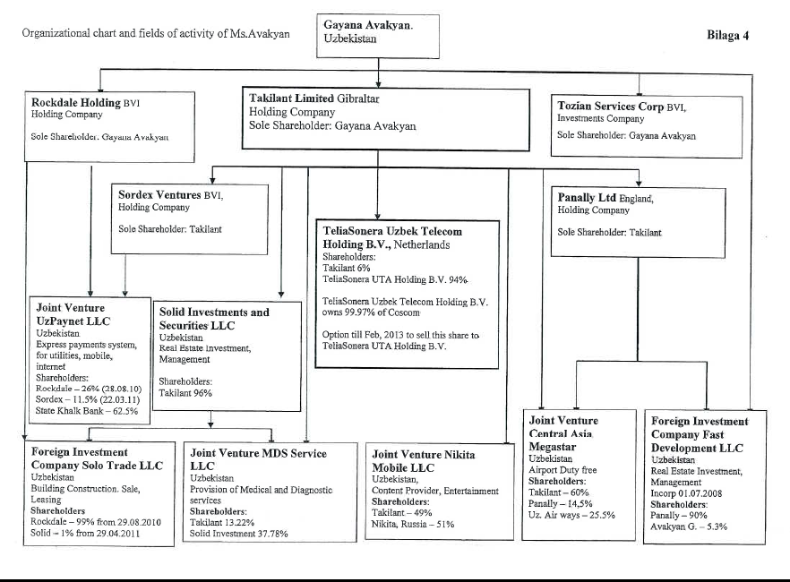
Onshore/Offshore

Slide 16
Banking/Property
April 2013 Norwegian financial regulator issued written warning and fine to Nordea bank
  The bank failed to carry out adequate due diligence on an account opened by Gayane Avakyan on behalf of Takilant.
  Takilant paid 200m SEK to this account in a series of six transactions. The bank carried out no further due diligence after the account was opened, despite:
    Large sums being transferred from a Gibraltar-registered offshore company
    Account-holder a national of a 'high-risk' country for money-laundering.
Latvian regulators have also been investigating a payment to Takilant’s bank account in Parex bank.
Media reports identified 19 properties controlled by Karimova
Almost no serious money-laundering restrictions on property transactions in UK, Switzerland
At least £122 bn of property in UK held by offshore companies, esp. BVI and Channel Islands
Notes:
(June2012-2013L fines for breaches of money-laundering regulations by estate agents.
Notes sherpa case in France, Spanish Association for HR – targeted family of Equatorial Guinea in 2008

Slide 17
Anti-Corruption Campaign
Legal/policy framework
  Uzbekistan acceded to the UN Convention against Corruption in 2008
  In 2010 it adopted the Istanbul Action Plan on Combating Corruption of the Organization for Economic Cooperation and Development (OECD).
  In 2010 a draft National Plan for Fighting Corruption was reportedly initiated but has subsequent fate unclear
  Presidential resolution of 29 October 2012 set up a commission to draft a law ‘On Combating Corruption’.
  Early February 2014 reported that law on state procurement was being developed, but progress has been extremely slow
Institutional measures
  Some reforms to state procurement and taxation procedures
  Some liberalisation of business registration and other requirements
Punitive measures
  Series of high-profile arrests, conducted in selective manner
  Long prison sentences and widespread abuse of due process, human rights

Slide 18
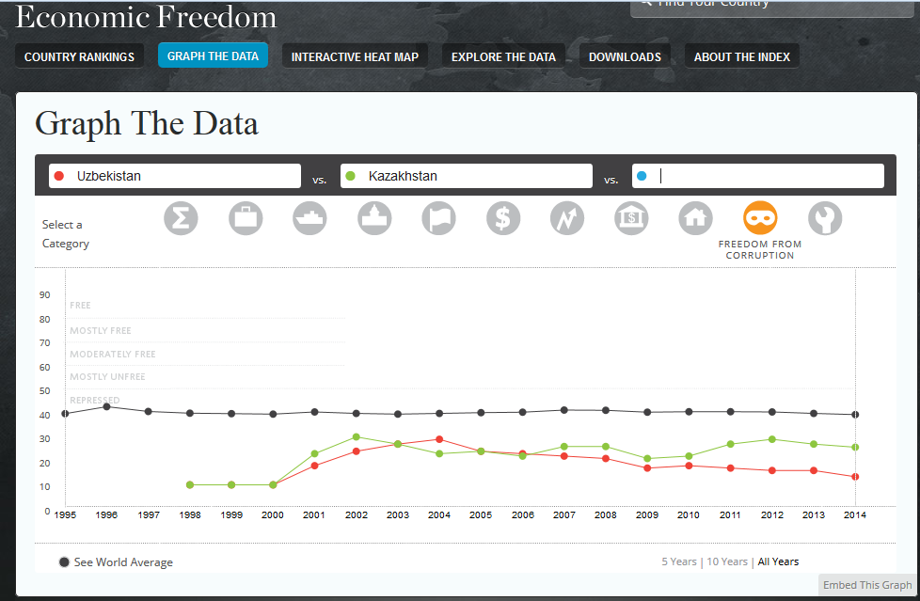

Slide 19
Conclusions
Closing institutional gaps extremely difficult without political reform
Corruption is an integral part of present political system, and tackling corruption is a political issue
Existing reforms may limit some discretionary powers, but will not affect major systemic challenges
Lack of information, freedom to research, investigate and report makes policy development difficult
Political reform is not sufficient to tackle corruption – requires institutional measures and justice sector reform
Anti-corruption measures may also result in:
  human rights abuses
  abuse of due process
  restrictions on economic activities
  destabilisation of political environment
Notes:
Rule of law, separation of powers -

