Slide 1

The Power of Investigative Journalism
Investigative Journalists of Armenia
www.hetq.am

Slide 2
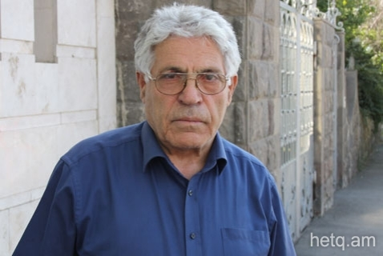
Offshore Scandal in Armenia
2013-2014
Paylak Hayrapetyan (Businessman A)

Slide 3
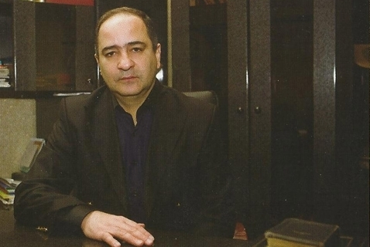
Offshore Scandal in Armenia
Ashot Sukiasyan (Businessman B)

Slide 4
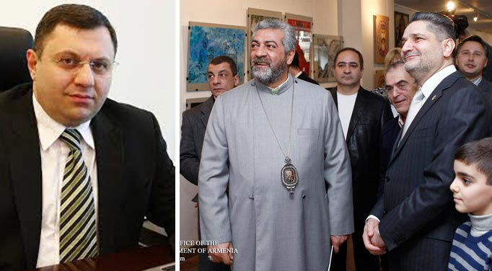
Connected People
Minister of Economy, Archbishop, Prime Minister

Slide 5
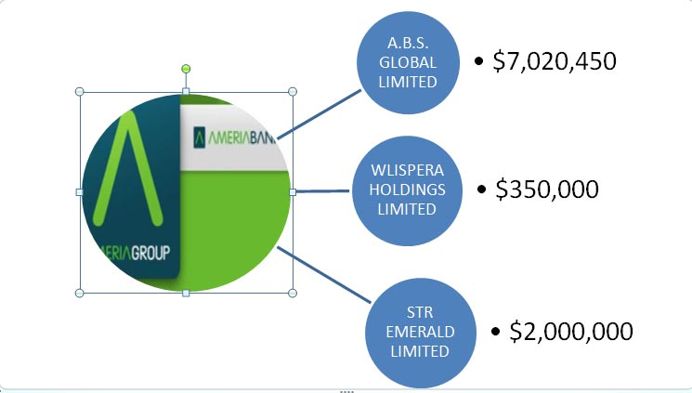
Bank Transfers to Offshore Companies
Ameriabank

Slide 6
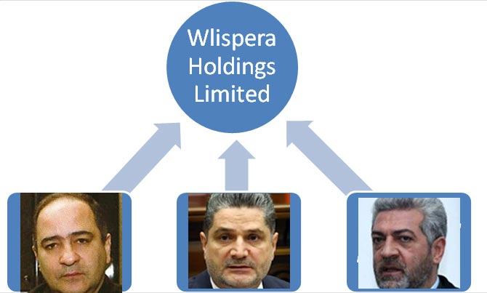
Shareholders
Ashot Sukiasyan Prime Minister Archbishop

Slide 7
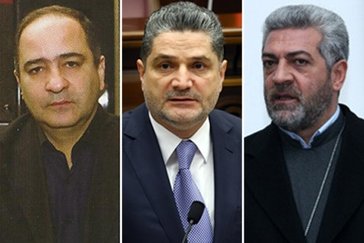
Shareholders of Wlispera Holdings Limited

Slide 8
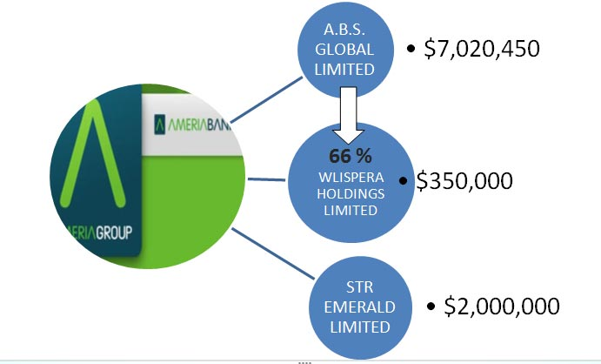
Bank Transfers to Offshore Companies
Ameriabank

Slide 9
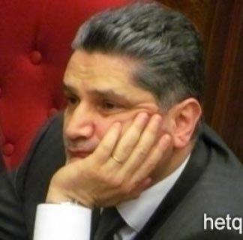
Prime Minister of Armenia
“This is nonsense. I never registered, nor did I authorize anyone to register such a company. And it is clear what this means. If you want to slander someone, this is a fabulous way and opportunity of doing so.”

Slide 10
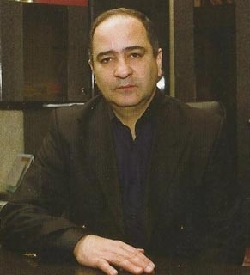
Ashot Sukiasyan
(Businessman B)
“I used their names in order for the business to avoid any outside hassle or interference. It never dawned on me that it would lead to such consequences.”

Slide 11
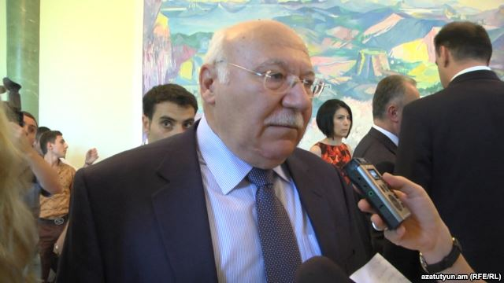
General Prosecutor of Cyprus
“Of course, it is impossible, without the consent of the authorized person.”

Slide 12
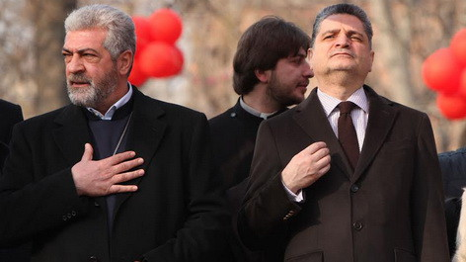
Amen!

Slide 13
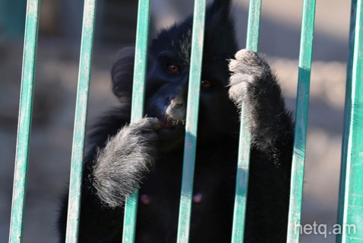
The Sale of Endangered Animals

Slide 14
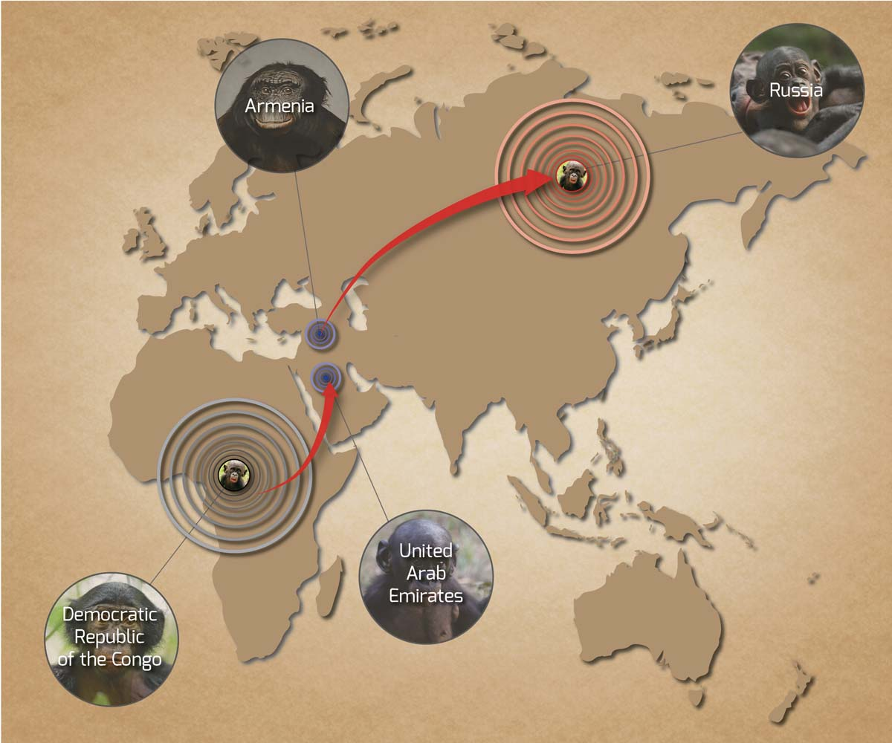
Armenia is a transit country for endangered animals

Slide 15
National Statistical Service of Armenia
286 primates were imported in 2011.
43 monkeys of various species were exported to Russia in 2011.
133 primates were imported in 2012.
111 monkeys were exported to Russia in 2012.

Slide 16
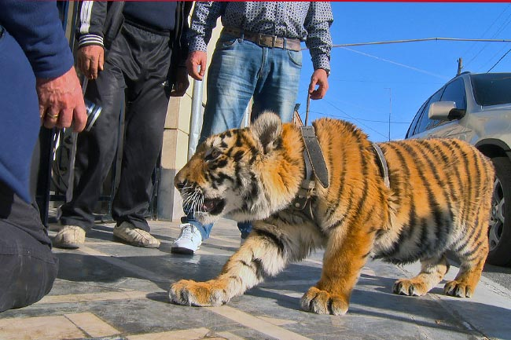
A tiger prowls the grounds of the Etchmiadzin home of Manvel Grigoryan, a member of the Armenian National Assembly and a retired Lieutenant General. The animal serves as a formidable security deterrent in addition to human guards.

Slide 17
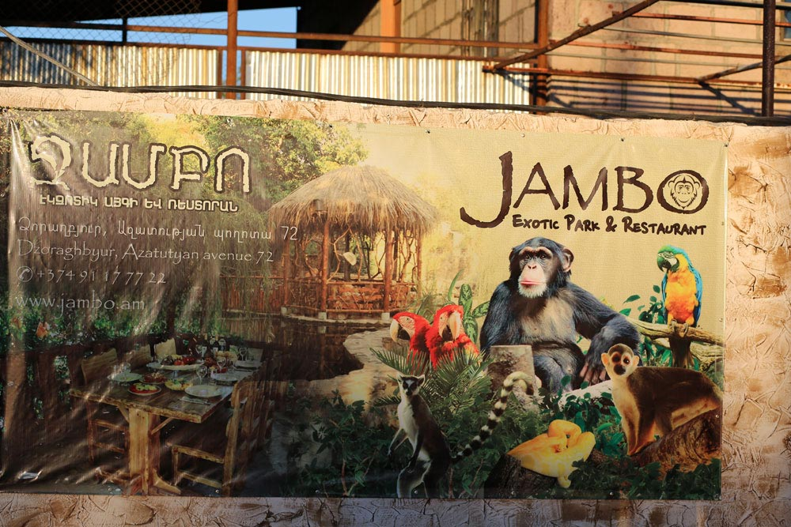
An Exotic Park & Restaurant Near Yerevan

Slide 18
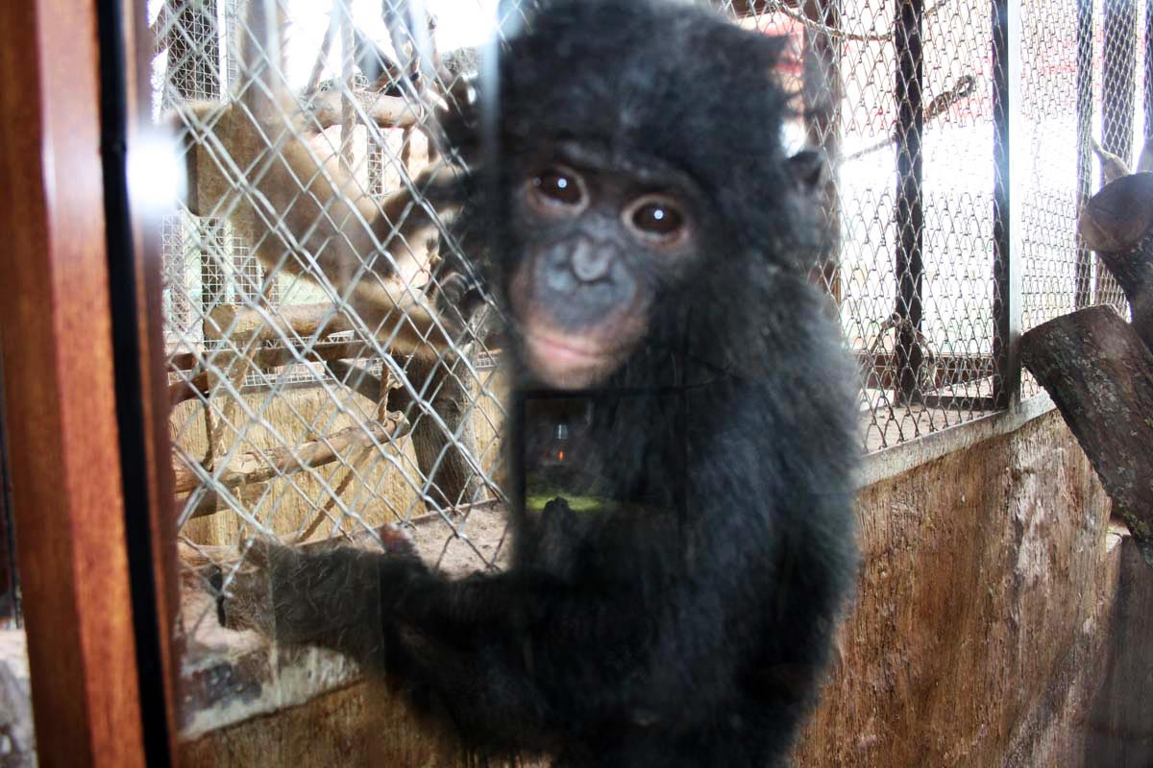
Bonobo in Jambo Park
Native to the Congo River basin in the Democratic Republic of the Congo (DRC), the species has been listed as endangered on the International Union for Conservation of Nature (IUCN) Red List since 1996.

Slide 19
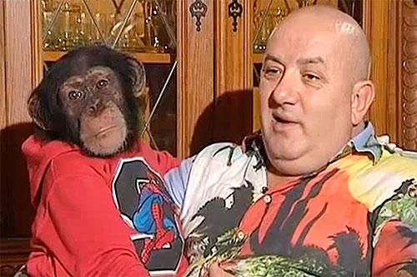
Artyom Vardanyan: “Such an animal can fetch 150,000 Euros on the open market. I purchased it and paid a large sum.”

Slide 20
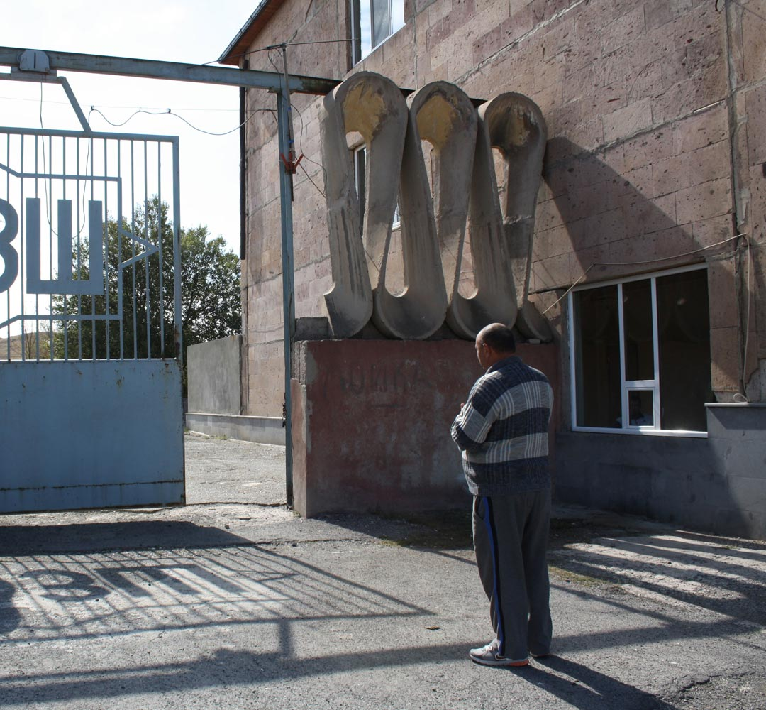
Importer, Owner of Zoo Fauna Art Ltd
“These monkeys have been legally imported. I know the CITES convention back and forth by heart. You are mistaken.”

Slide 21
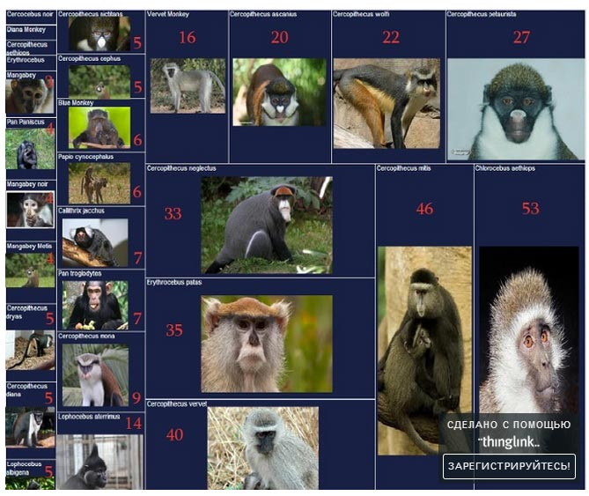
Monkeys Imported to Armenia

Slide 22
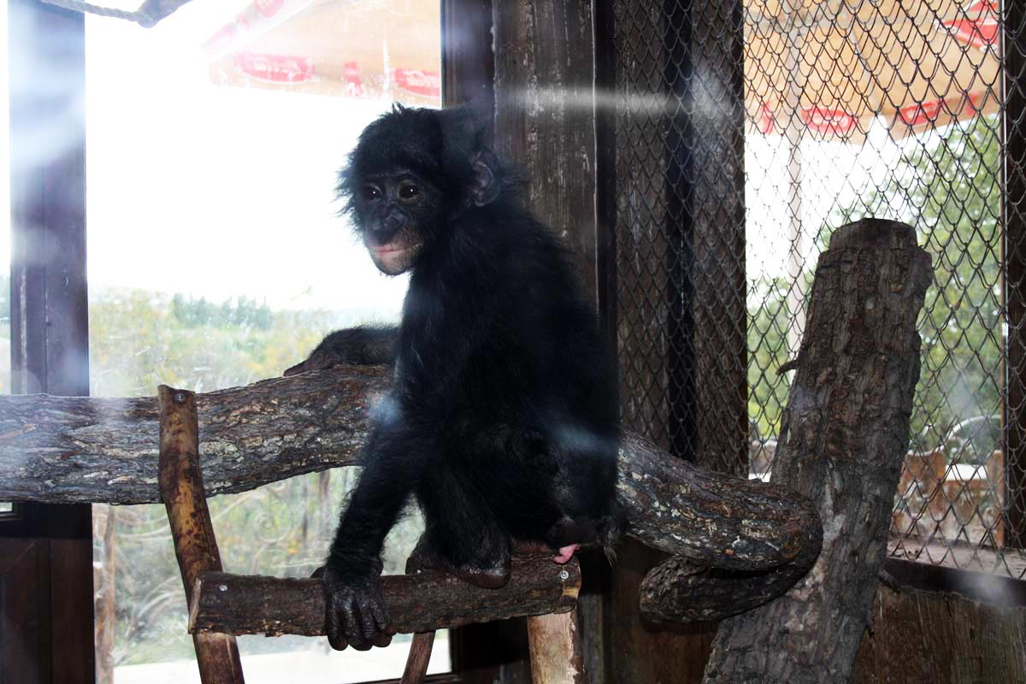
The park owner claimed in testimony that the bonobo died from an illness in December 2013

Slide 23
Results
Police launched an investigation
Interpol is now investigating the trafficking of endangered animals via Armenia
Court case against the Ministry of Nature Protection
Negative result: the bonobo disappeared

Slide 24
Thanks for your patience and attention!

