Slide 1

EU election and attitudes towards European Union
July, 2014.
Notes:
1

Slide 2
Methodology
1

Slide 3
Methodology
Online survey in 15 EU countries
Target population: citizens living in the respective country aged 18-39
Quota sample in most of countries (with the exception of Denmark, Austria and Greece) – quota defined by gender, age and region
Sample size: 14400 respondents in total; 1000 respondents in most of countries, with the exception of Denmark, Austria and Greece (800 respondents per country)
Questionnaire length – app. 10 minutes
Data collection period: May, 30th to June, 17th 2014

Slide 4
Legend
EPP : Group of the European People's Party (Christian Democrats)
S&D : Group of the Progressive Alliance of Socialists and Democrats in the European Parliament
ECR : European Conservatives and Reformists
ALDE : Alliance of Liberals and Democrats for Europe
GUE/NGL : European United Left/Nordic Green Left
Greens/EFA : The Greens/European Free Alliance
EFDD : Europe of freedom and direct democracy
NI : Non-attached Members – Members not belonging to any political group

Slide 5
EU election
2

Slide 6
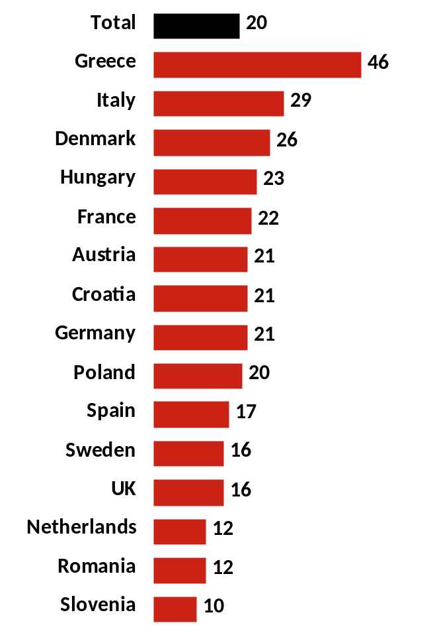
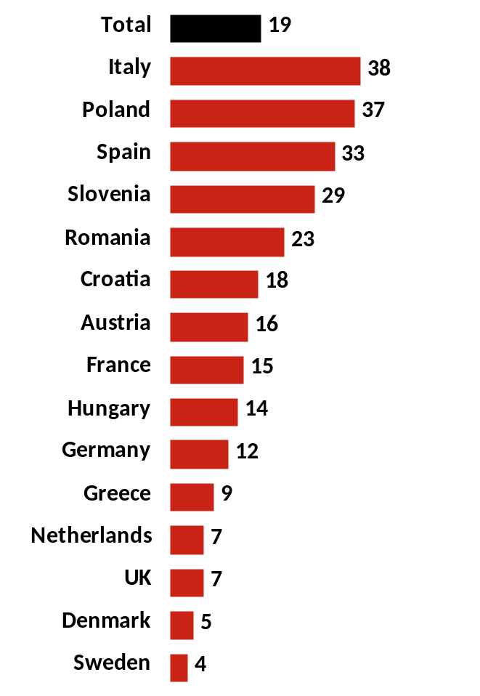
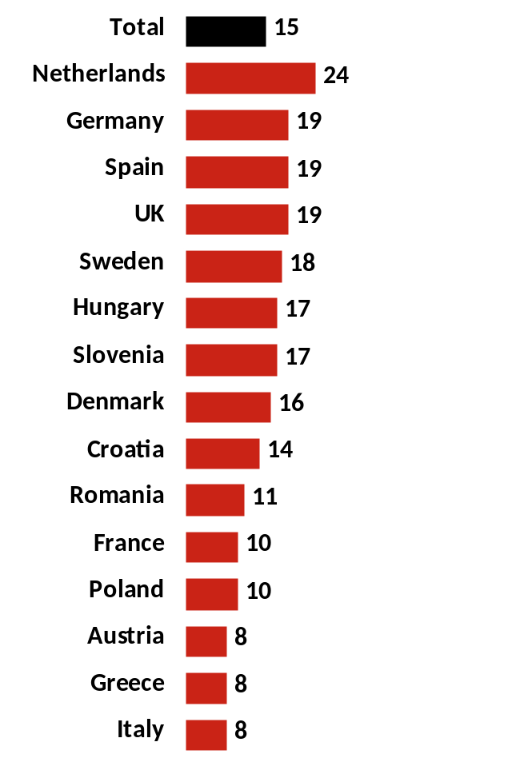
Being prevented to vote (20%), the lack of adequate political option (19%) and the lack of interest in politics (15%) are the main reasons for not voting in EU elections.
I was prevented to vote
( illness, other obligations...)
None of the parties / lists which run for election deserve my vote
I am generally disinterested in politics
Base: Those who did not vote

Slide 7
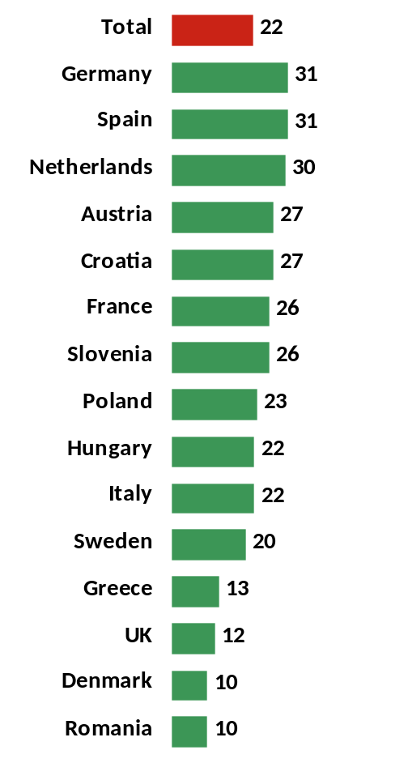
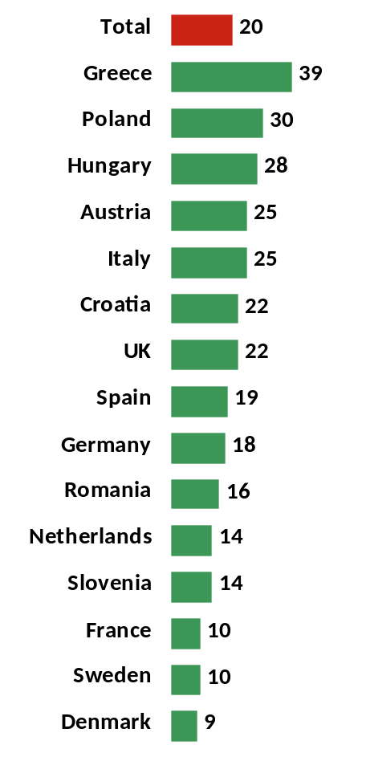
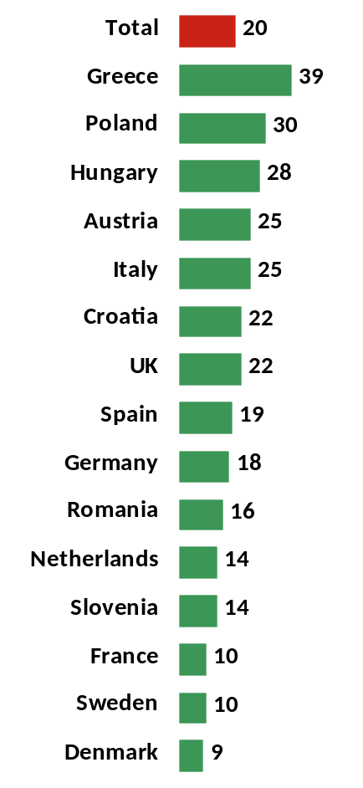
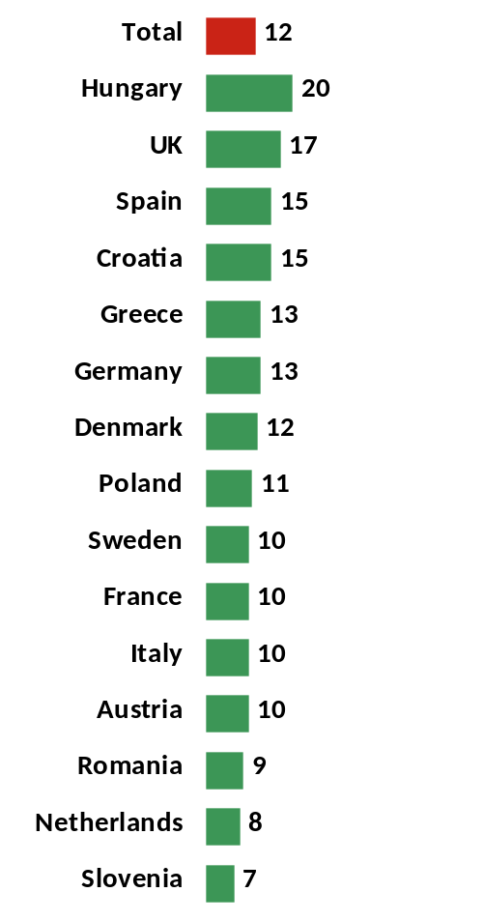
The programme of the party (22%), being the least bad alternative (20%), politics towards EU (20%) and politics on the national level (12%) are the most important reasons for voting in EU elections.
Due to the programme of that party
They are the least bad of all other parties
Due to politics of that party / list towards EU
Due to their politics on national level
Base: Those who voted

Slide 8
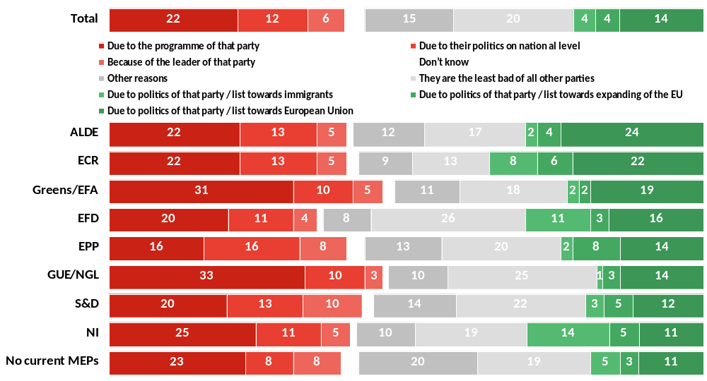
Pure political reasons are the most important reasons for voting among ALDE (24%), ECR (22%) and Greens (19%) voters, while NI, EFD and ECR voters are more often attracted by the attitude towards immigrants than the voters of other parties.
What was the main reason why you decided to vote for that particular party / list for European Parliament?
Base: Those who voted

Slide 9
Among people who didn’t vote women (22%) were more often prevented to vote than males (16%). Males (22%) more often claim that there is no party they would support than females (16%). People with higher education level more often claim they were prevented to vote (25%), while people with lower education (19%) are less interested in politics.
Among those who voted there are significantly more highly educated people who opt for the political party because of the politics of the party towards EU (17%) while there is higher number of people with lower education level who vote for the party because of the program towards immingrants (6%).

Slide 10
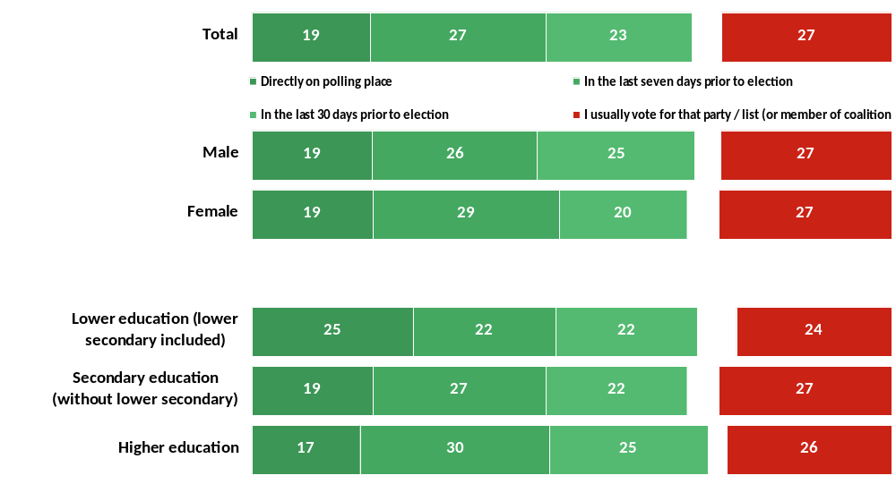
When did you make the decision about the party/list that you would vote for?
Almost half of all voters made decision in last seven days prior to election (46%) – among them, almost 20% decided directly on the polling place (19%). Only ¼ of all voters vote for the party they usually support (27%).
Gender
Education
Base: Those who voted

Slide 11
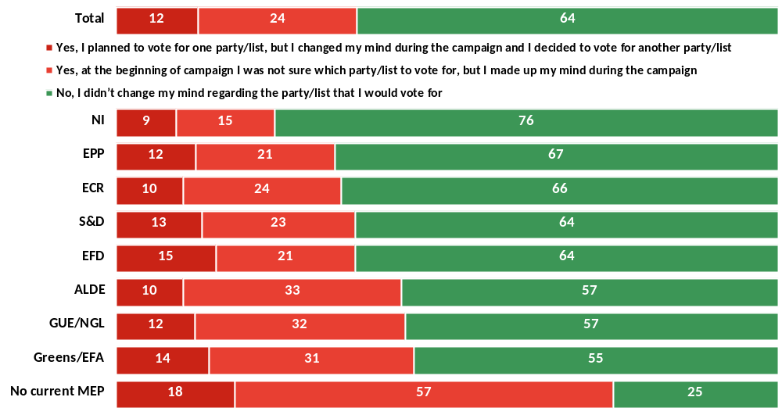
64% of those who voted didn’t change their opinion during campaign. NI, EPP and ECR supporters more often decided to vote during the campaign.
During the electoral campaign for European Parliament did you maybe change the initial decision about the party/list that you would vote for?
Base: Those who voted

Slide 12
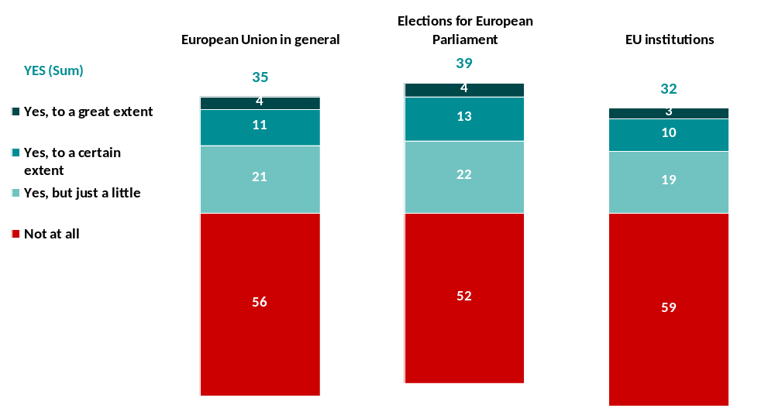
Did the electoral campaign for European Parliament increase the extent of your knowledge about...
More than 50% of people claim that campaign didn’t increase their knowledge about EU, EU elections and EU institutions at all, while 32 – 39% people think that electoral campaign increased their knowledge about these topics.
Base: Total population – Citizens aged 18-39 from 15 EU countries

Slide 13
Effects of the electoral campaign
Electoral campaign had more effect on increasing knowledg about EU in general among males (38%) than females (33%), and more often didn’t have any effect among highly educated people(58%).
Also, campaign had a little bit more effect on increasing knowledge about EU elections of people with secondary education (42%), as well as contributed increasing knowledge about EU institutions more often amog males (34%) than females (29%).

Slide 14
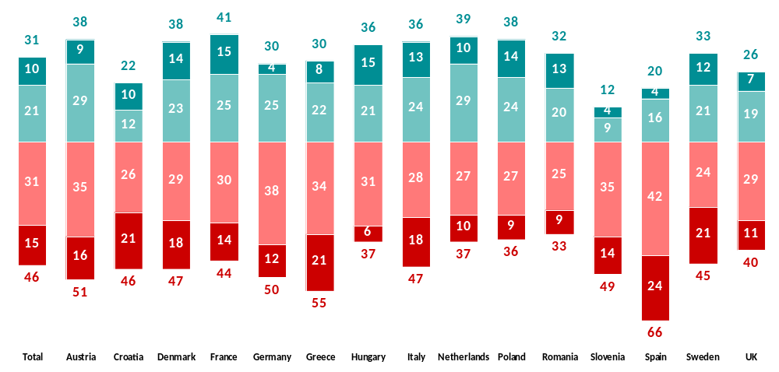
Slightly higher number of right oriented people is registered In Austria, Denmark, France, Netherlands and Poland, , while there is more than average left oriented in Greece and Spain
Please think for a moment about your political orientation. If you had to define yourself on the scale from 1 to 10, where 1 means that you support the extreme leftist ideas, and 10 means that you support the extreme rightist ideas, on which step do you think that you currently are?
○ | Right (sum 8 to 10) | ○ | Right center (sum 6 to 7) | ○ | Left center (sum 4 to 5) | ○ | Left (sum 1 to 3)
RIGHT (sum 6 to 10) |  |  |  |  |  | LEFT (sum 1 to 5)
Base: Total population – Citizens aged 18-39 from 15 EU countries

Slide 15
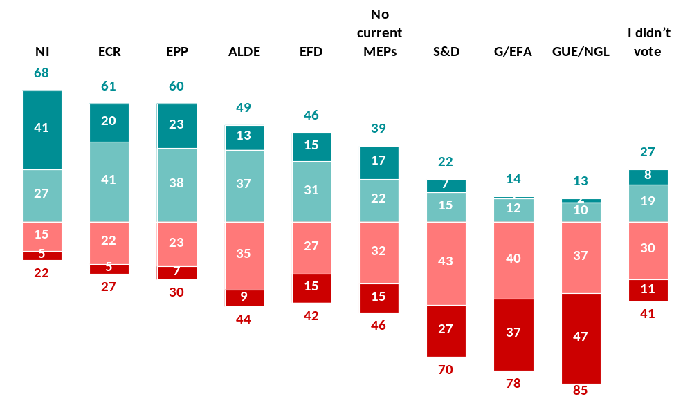
Among those who did not vote in the elections there is significantly more left oriented
Please think for a moment about your political orientation. If you had to define yourself on the scale from 1 to 10, where 1 means that you support the extreme leftist ideas, and 10 means that you support the extreme rightist ideas, on which step do you think that you currently are?
RIGHT (sum 6 to 10)
○ | Right (sum 8 to 10)
○ | Right center (sum 6 to 7)
○ | Left center (sum 4 to 5)
○ | Left (sum 1 to 3)
LEFT (sum 1 to 5)
Base: Total population – Citizens aged 18-39 from 15 EU countries

Slide 16
Attitudes towards European Union
3

Slide 17
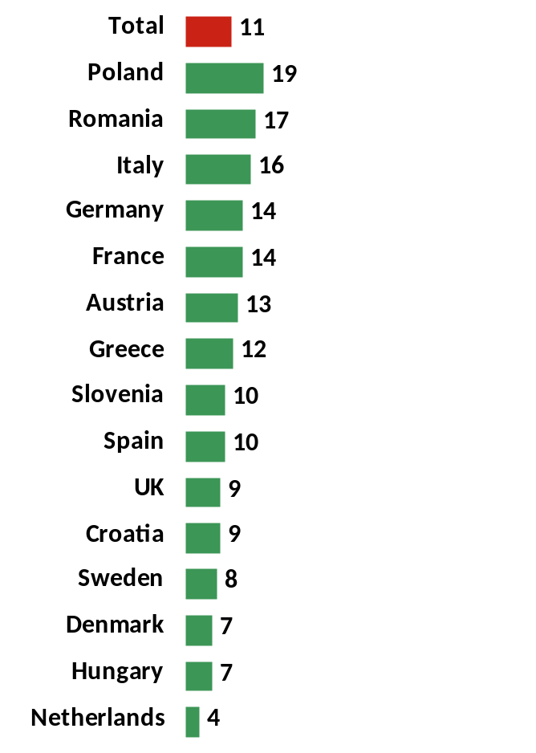
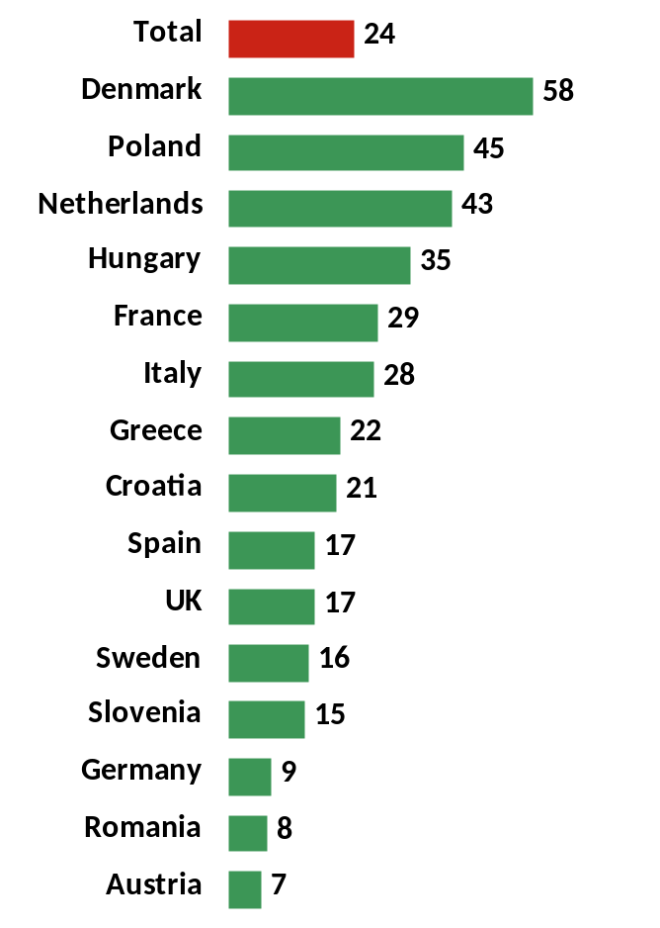
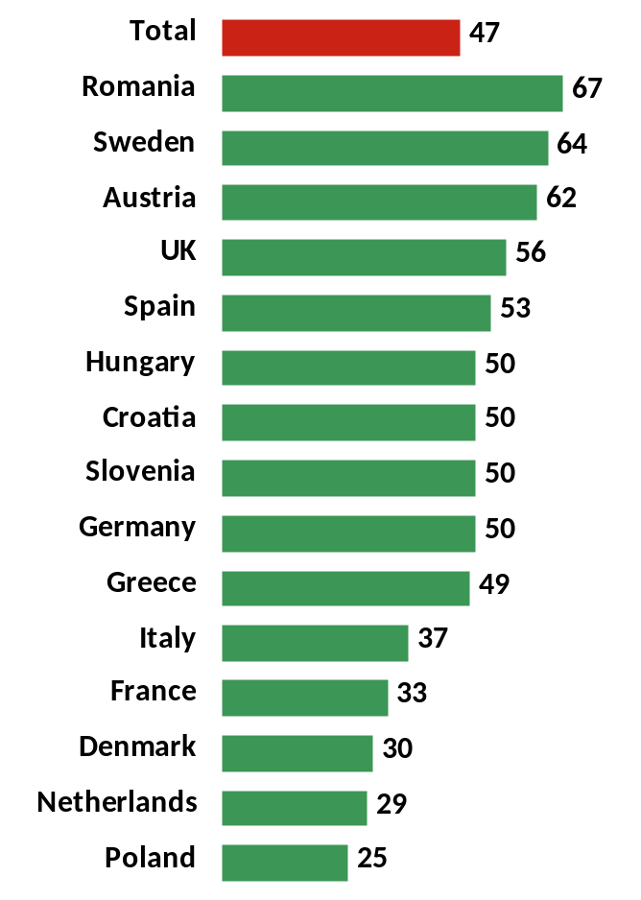
Most people consider themselves primary the citizens of the country they live in (47%). Slightly over 10% of people living in 15 EU countries claim they are primarily citizens of Europe (11%).
Primarily the citizen of Europe
Primarily the member of your nation
Primarily the citizen of the country you live in
Base: Total population – Citizens aged 18-39 from 15 EU countries

Slide 18
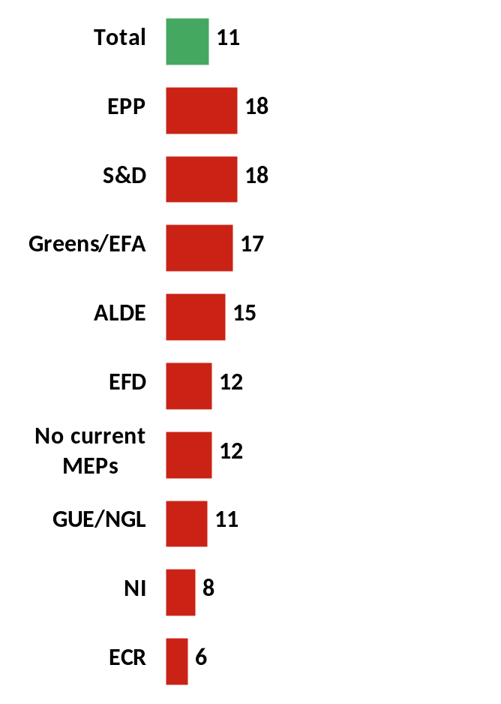
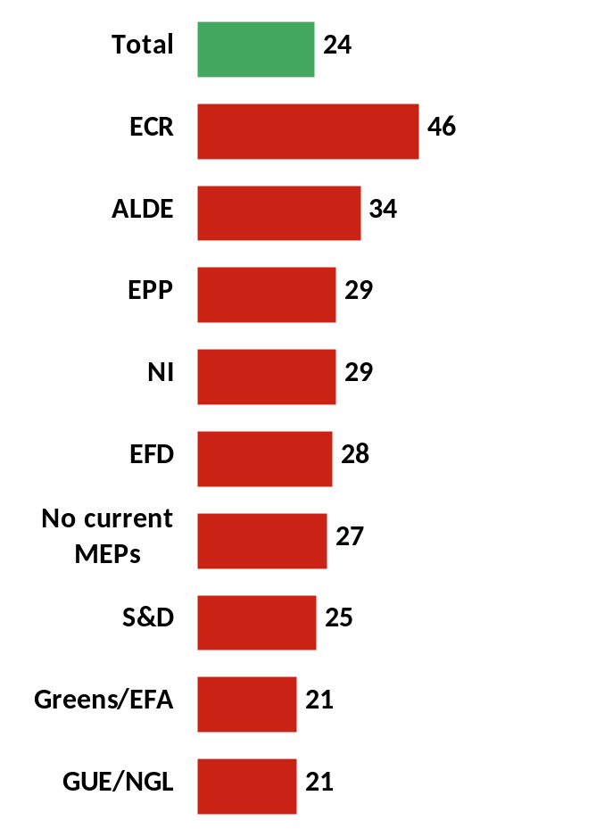
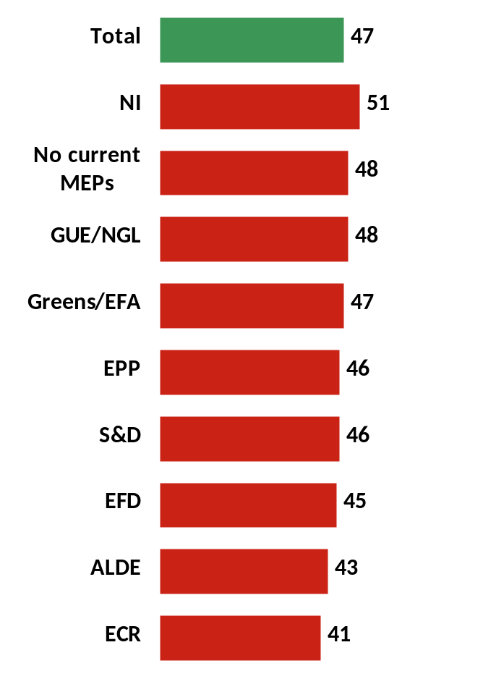
Voters of S&D (18%), EPP (18%), G/EFA (17%) and ALDE (15%) more often identify themselves as citizens of Europe than on total (11%). ECR (46%), ALDE (34%) and EPP (20%) supporters more often identify themselves as members of their nation.
Primarily the citizen of the country you live in
Primarily the citizen of Europe
Primarily the citizen of the country you live in
Primarily the citizen of Europe
Primarily the member of your nation
Primarily the member of your nation
Base: Total population – Citizens aged 18-39 from 15 EU countries

Slide 19
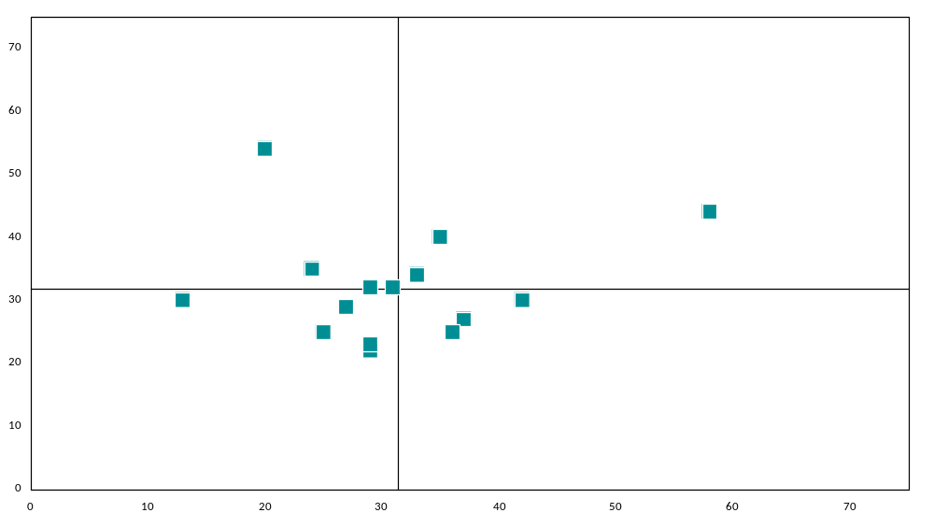















Positive attitudes toward EU are more often characteristic of people living in Romania, Germany and Italy
Denmark
Romania
The European Union survive more than 20 years
Austria
Germany
Spain
Italy
Ø 31,9
France
Poland
Netherlands
Sweden
UK
Hungary
Slovenia
Greece
Croatia
Ø 31,3
The European Union offers great opportunities to its citizens
Base: Total population – Citizens aged 18-39 from 15 EU countries

Slide 20
OPINION ON THE EU
17.4% of people living in 15 EU countries believe EU is a very bad option for the country they live in; this is an attitude of 34% of Slovenians, 25% of Austrians and Croats, 23% of Italians.
Moreover, 22% of EU citizens believe EU is necessary evil they accept because of the lack of other ideas. In total, there is 40% of citizens who think EU is not a good option for themselves and country they live in.
Less than 1/3 of people from 15 countries covered in the survey believe that EU offers great opportunities to its citizens. This is more often characteristic of people with higher education, those living in big cities and voters of EPP (52%), ALDE (50%), S&D (49%) and G/EFA (46%). Euro skepticism is more often characteristic of NI, EFD and ECR voters (44%, 44% and 28% respectively).
30% of people do not know for how long EU will survive, and almost 1/3 believe EU will last longer than 20 years. Most pessimistic about EU future are those who believe EU will survive up to five years – 6.7% in total.
Euro skepticism is more often characteristic of people with lower education and those living in villages and small towns, citizens of Greece, Italy, Slovenia and UK and voters of NI and GUE/NGL.
Positive expectations about EU future have people with higher education and from big cities, as well as citizens of Denmark, Romania and Germany and voters of ALDE, G/EFA, EPP and S&D.

Slide 21
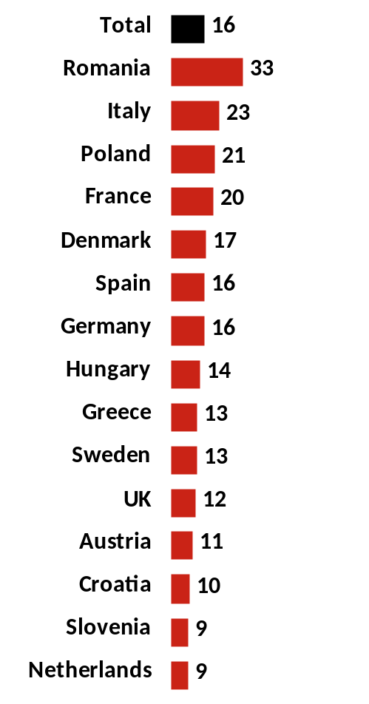
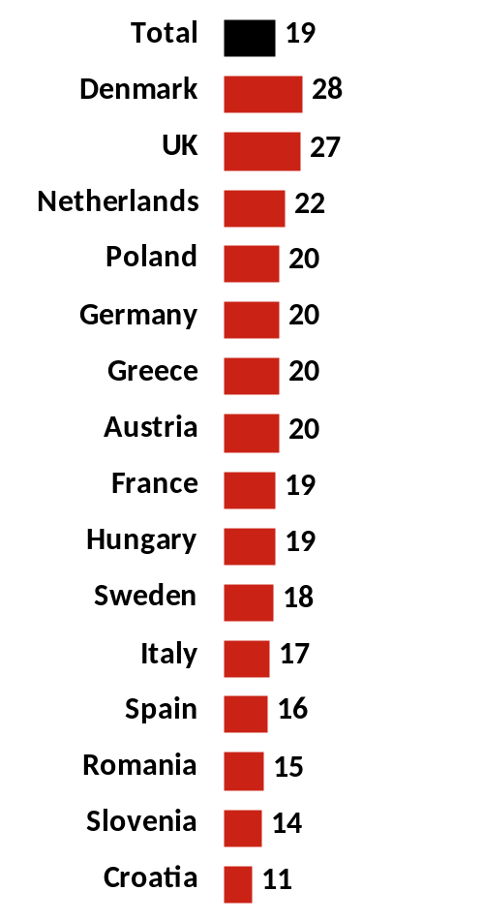
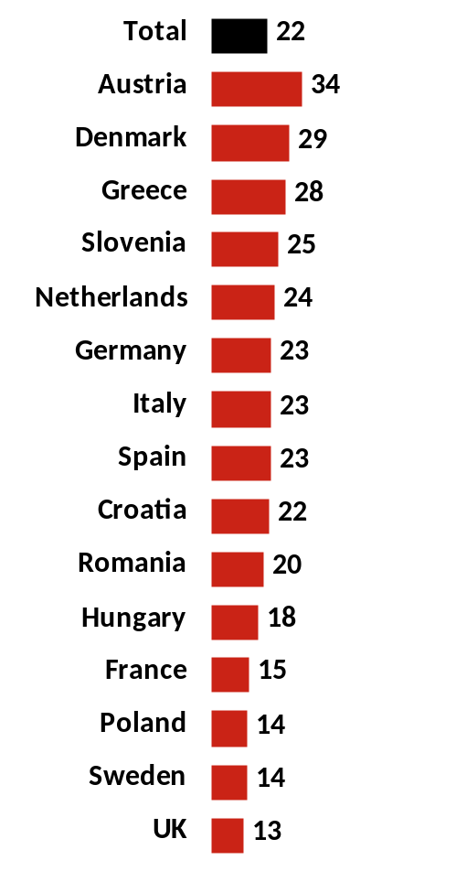
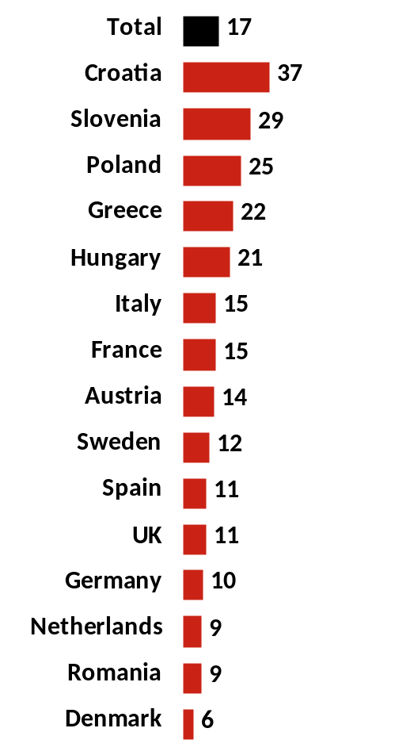
More than ¼ of (18-39) citizens of 15 countries do not know what will happen with EU in the future. 17% of EU citizens believe EU will not survive, and 16% believe EU will be more integrated and at service of its citizens.
In your opinion, what will happen with the European Union in the future?
EU will become more integrated and at the service of its citizens
EU will survive, but jurisdictions of the Brussels administration will be reduced...
EU will survive, but jurisdictions of the Brussels administration will be increased
The European Union will not survive
Base: Total population – Citizens aged 18-39 from 15 EU countries

Slide 22
Attitudes towards LGBT persons are more positive than attitudes towards immigrants – 15% believe EU would be better place If LGBT persons would not be given all the rights
In your opinion, would the European Union be better or worse if something of the following happened?
If there were less immigrants in the country you live in; If LGBT persons would not be given all the rights other citizens have
If there were less immigrants in the country you live in
If LGBT persons would not be given all the rights other citizens have
the European Union be better...
Base: Total population – Citizens aged 18-39 from 15 EU countries

Slide 23
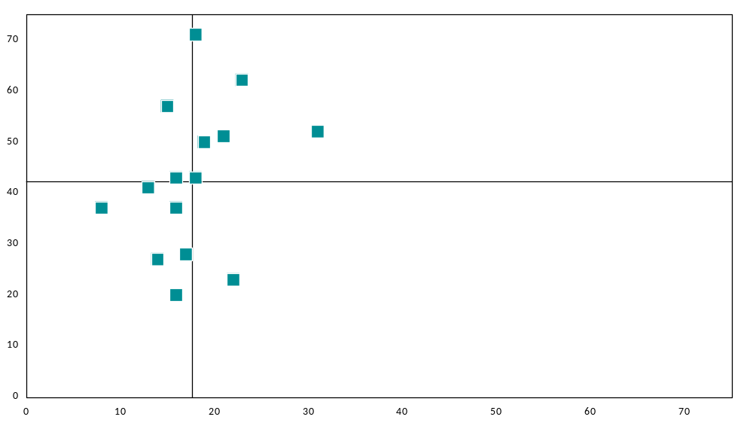
In your opinion, would the European Union be better or worse if something of the following happened?
Denmark
LGBT+ IMMIGRANTS -
LGBT+ IMMIGRANTS +
Spain
Netherlands
Germany
Sweden
UK
Austria
Ø 42,4
Hungary
Slovenia
The EU would be worse If LGBT persons would not be given all the rights other citizens have
Greece
Croatia
Italy
France
Romania
Poland
LGBT- IMMIGRANTS -
LGBT- IMMIGRANTS +
Ø 17,6
The EU would be worse If there were less immigrants in the country you live in
Base: Total population – Citizens aged 18-39 from 15 EU countries

Slide 24
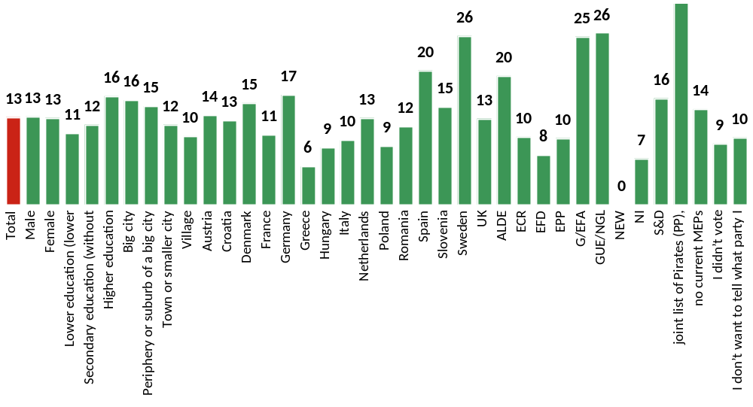
Friendly towards LGBT and immigrants - profile
Country
Which party/list did you vote for on election for European Parliament?
Gender
Education
Place of living
Base: Those who are friendly towards LGBT population and immigrants

Slide 25
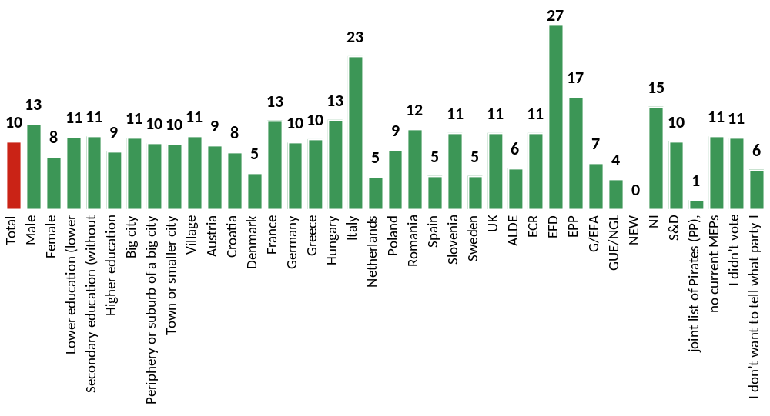
Non-friendly towards LGBT and immigrants - profile
Country
Which party/list did you vote for on election for European Parliament?
Gender
Education
Place of living
Base: Those who are not friendly neither towards LGBT population nor immigrants

Slide 26
WHAT DO THEY THINK ABOUT IMMIGRANTS AND LGBT POPULATION
Attitudes of 15 EU countries citizens towards immigrants are mostly negative – 39% believe EU would be better place for living if there were less immigrants, 18% believe it would be actually better place, and 43% do not have attitude on this issue.
Negative attitudes towards immigrants more often have males, people with lower education, living in villages and suburbs, citizens of Greece, Italy, Austria, France, voters of NI, EFD, ECR and EPP. EU would be worse place if there were less immigrants believe people with higher education, from big cities, living in Sweden, Spain, Romania, Germany and supporters of G/FA and GUE/NGL.
Attitudes towards LGBT persons are more positive than attitudes towards immigrants – 15% believe EU would be better place If LGBT persons would not be given all the rights other citizens have and 42% believe EU would be worse place to live under these circumstances. 43% do not have an opinion about this issue.
More positive attitudes, again, have females, person with higher education and those living in big cities, people living in Denmark, Spain, Netherlands, Sweden, Germany and Austria, as well as ALDE,G/EFA, GUE/NGL and S&D voters. Negative attitudes are characteristic of males, people living in Hungary, Italia and Romania, as well as voters of EFD, EPP and NI.

Slide 27
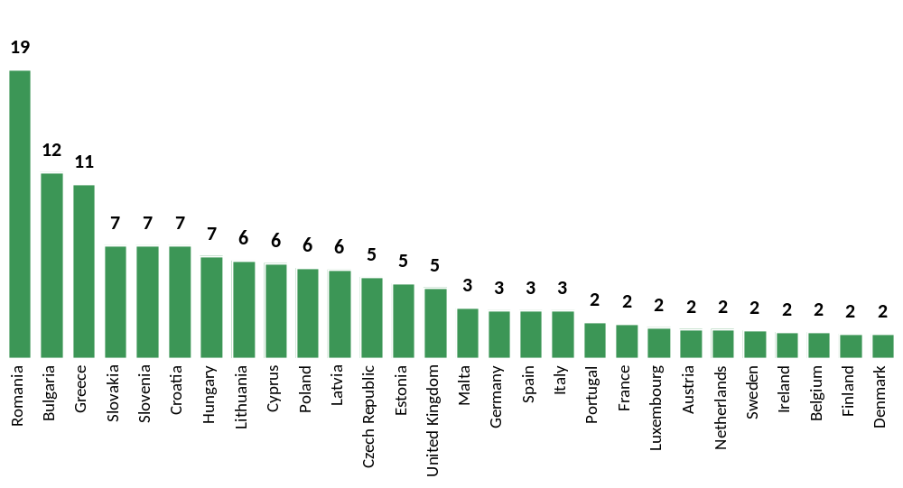
People of 15 EU countries covered by the survey most often point out Romania (19%), Bulgaria (12%) and Greece (11%) as countries that shouldn’t be EU member states.
In your opinion, which of the following member states do not deserve to be a part of the European Union?
Base: Total population – Citizens aged 18-39 from 15 EU countries

Slide 28
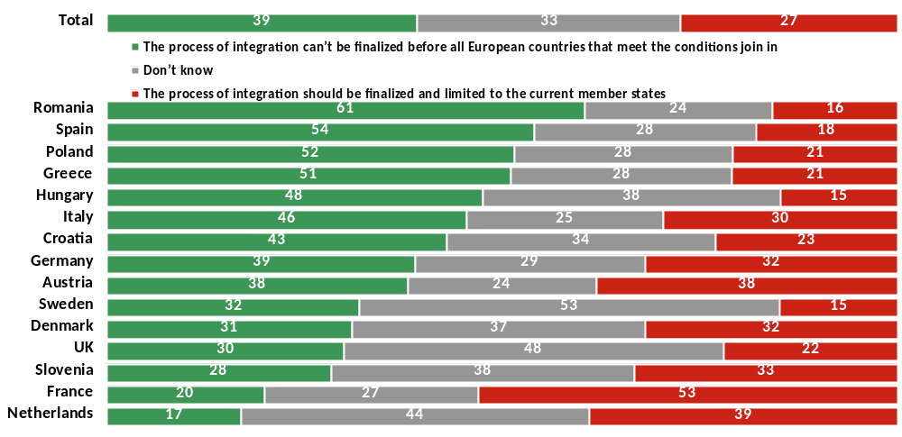
Almost 40% of EU citizens think that integration can’t be finalized before all European countries join EU, while app. ¼ of them think that integration process should be finalized and limited to the current member states.
Citizens of the European Union have different opinions on expanding the European Union. While some think that the process of integration can’t be finalized before all European countries that meet the conditions join in, others believe that the process of integration should be finalized and limited to the current member states. Which of these two opinion is closer to your own?
Base: Total population – Citizens aged 18-39 from 15 EU countries

Slide 29
EU MEMBER STATES IN THE FUTRE
Citizens of Romania, Spain, Poland, Greece, Hungary, Italy support integration process, as well as voters of GUE/NGL, S&D, G/EFA and EPP. People living in France, Austria, Netherlands, Slovenia, Denmark and Germany and ECR, NI and ALDE supporters think integration process should be stopped and limited to the current member states.
Attitudes towards benefits of being EU member state are divided. Highly educated people and those living in big cities believe being EU member is a beneficial for the country they live in. Eastern-European countries’ citizens attitudes toward EU membership are more often positive – they think they would live worse than now if their country wouldn’t be EU member state.
On the other hand, people living in Slovenia, Italy, Greece and Austria more often than citizens of other countries believe that they would live better if their country wouldn’t be EU member. ECR, EFD, GUE/NGL and NI voters have negative attitude on this issue, while EPP, G/EFA and S&D supporters believe EU membership is beneficial.
People living in Croatia, Hungary, Poland, Romania, Greece, Slovenia, Poland and Spain believe they live worse than people in other countries, while citizens of Denmark, Germany, Austria, Sweden, France, Netherlands and UK think their living standard is better.

Slide 30
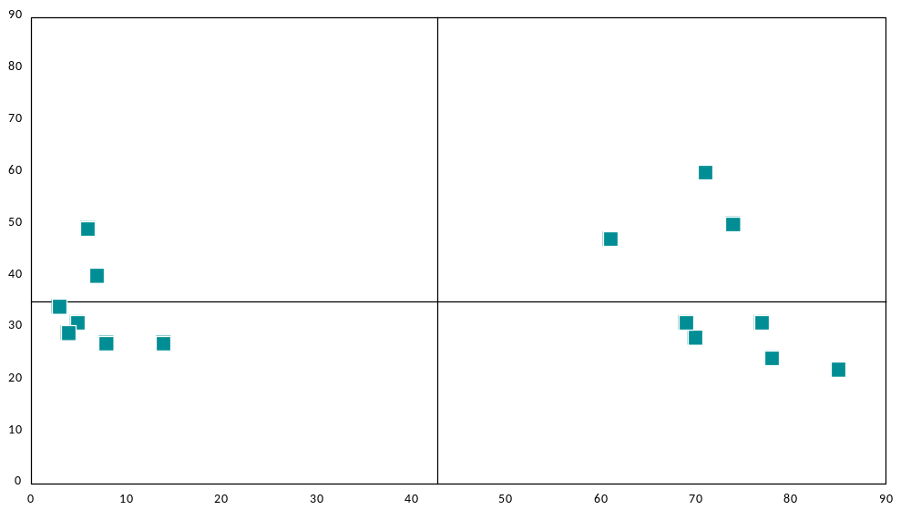
The current quality of life and future outside EU
Good life and better outside EU
Bad life and better outside EU
Slovenia
Austria
Greece
The citizens would live a lot better than now If the country they live in would not be a member of the European Union
Italy
Sweden
Netherlands
Ø 35,1
Germany
Spain
Romania
France
Poland
Hungary
Denmark
UK
Croatia
God life but not better outside EU
Bad life but not better outside EU
Ø 42,8
The citizens of my country have a worse life as citizens of most other EU member states

Slide 31
Thanks for your attention

