Slide 1


EU election and attitudes towards European Union
July, 2014.
Notes:
1

Slide 2
Methodology
1

Slide 3
Methodology
Online survey in 15 EU countries
Target population: citizens living in the respective country aged 18-39
Quota sample in most of countries (with the exception of Denmark, Austria and Greece) – quota defined by gender, age and region
Sample size: 14400 respondents in total; 1000 respondents in most of countries, with the exception of Denmark, Austria and Greece (800 respondents per country)
Questionnaire length – app. 10 minutes
Data collection period: May, 30th to June, 17th 2014

Slide 4
Legend
EPP : Group of the European People's Party (Christian Democrats)
S&D : Group of the Progressive Alliance of Socialists and Democrats in the European Parliament
ECR : European Conservatives and Reformists
ALDE : Alliance of Liberals and Democrats for Europe
GUE/NGL : European United Left/Nordic Green Left
Greens/EFA : The Greens/European Free Alliance
EFDD : Europe of freedom and direct democracy
NI : Non-attached Members – Members not belonging to any political group

Slide 5
Results
2

Slide 6
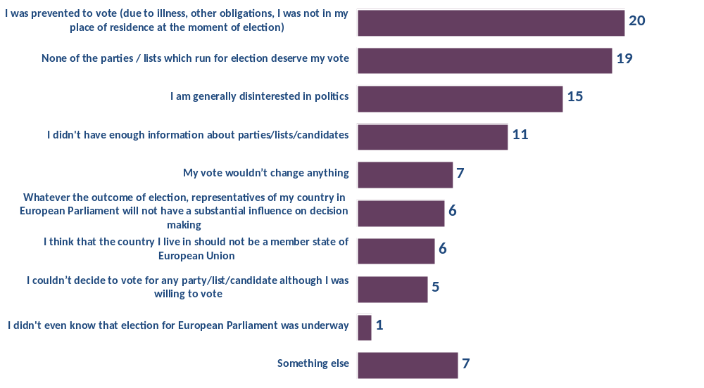
Which of the following reasons is the most important reason due to which you didn’t vote?
Base: Those who did not vote (56% of total population)

Slide 7
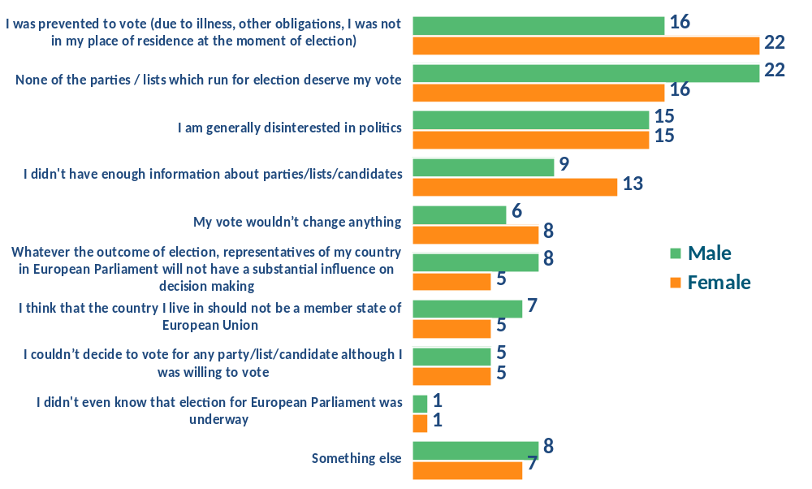
Which of the following reasons is the most important reason due to which you didn’t vote?
Base: Those who did not vote (56% of total population)

Slide 8
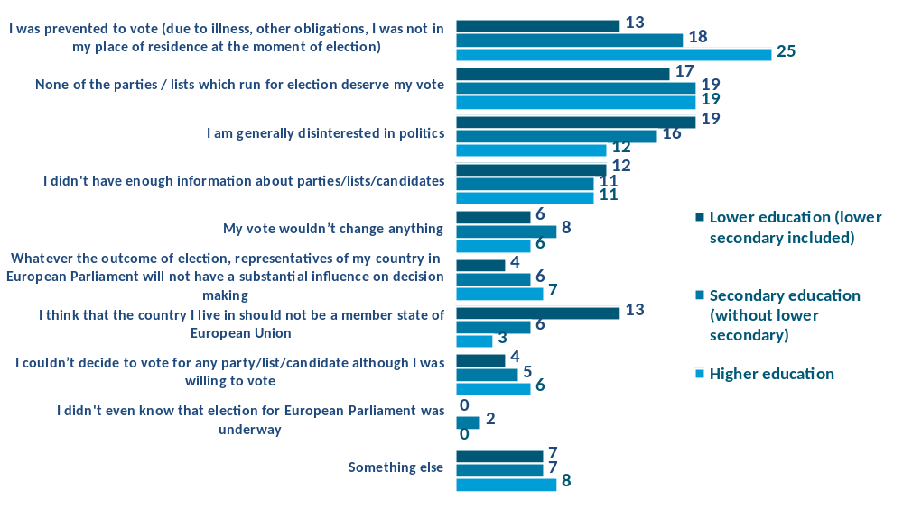
Which of the following reasons is the most important reason due to which you didn’t vote?
Base: Those who did not vote (56% of total population)

Slide 9
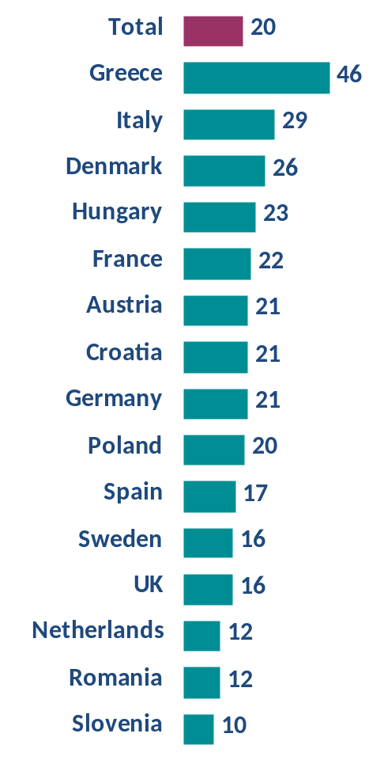
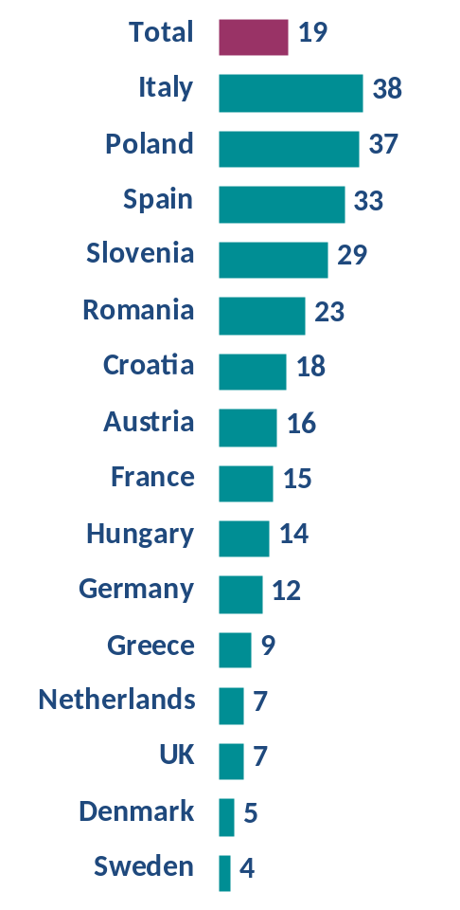
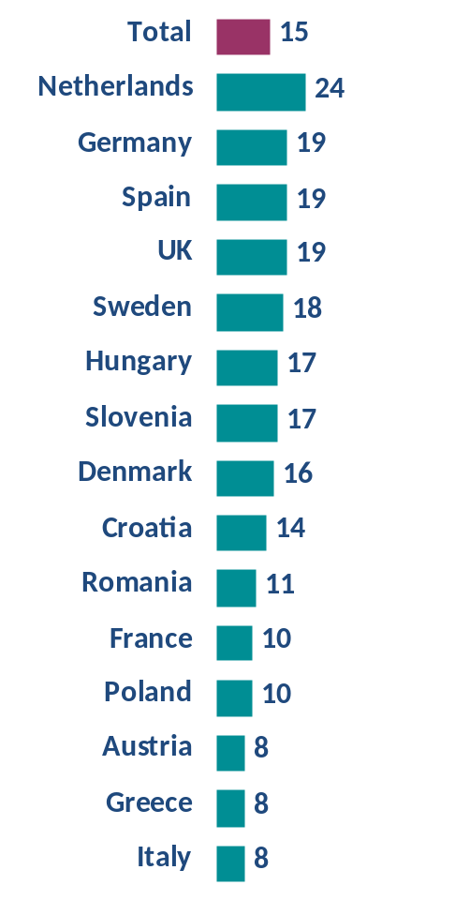
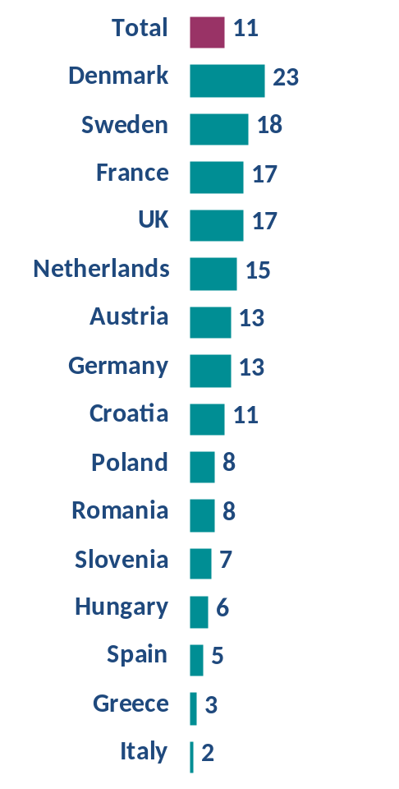
Which of the following reasons is the most important reason due to which you didn’t vote?
By reason
I was prevented to vote
( illness, other obligations...)
None of the parties / lists which run for election deserve my vote
I am generally disinterested in politics
I didn't have enough information about parties/lists/candidates
Base: Those who did not vote (56% of total population)

Slide 10
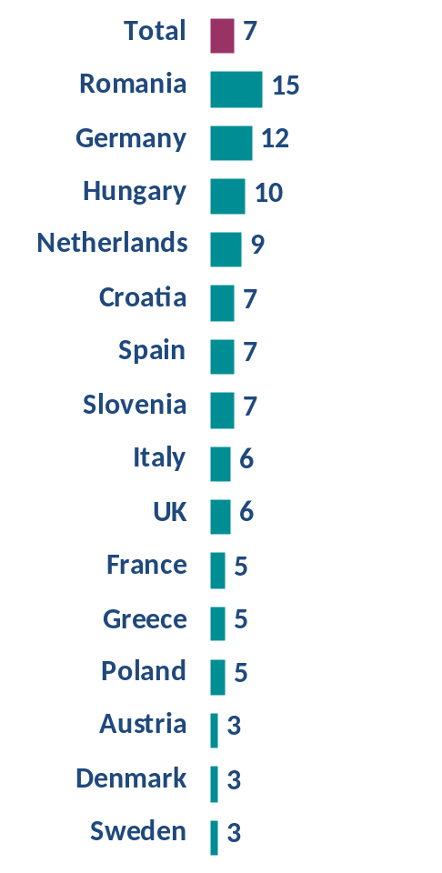
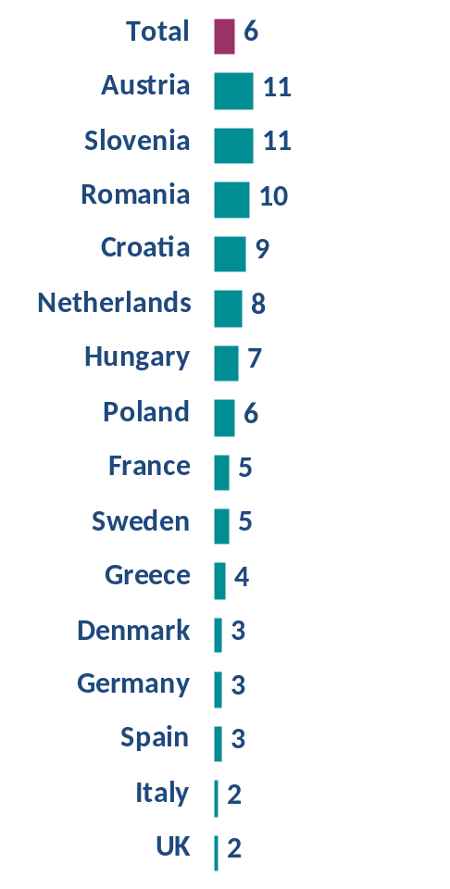
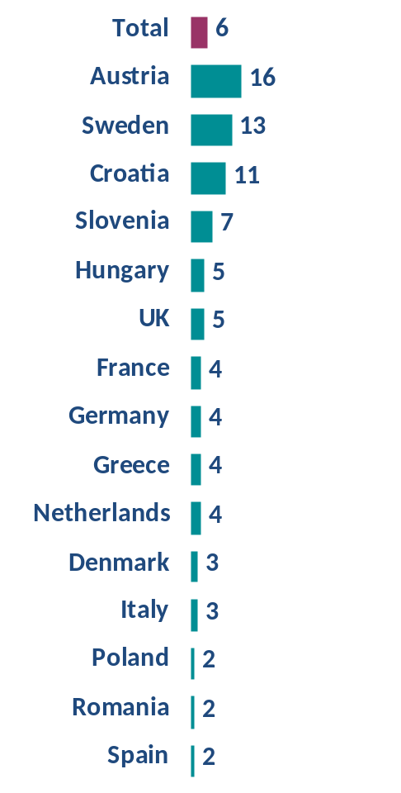
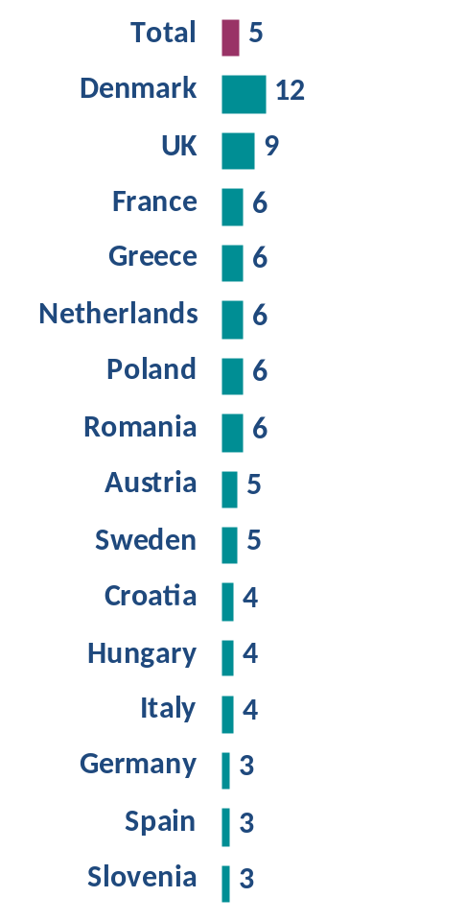
Which of the following reasons is the most important reason due to which you didn’t vote?
By reason
My vote wouldn’t change anything
Representatives of my country in EU Parl. will not have a substantial influence
I think that the country I live in should not be a member state of European Union
I couldn’t decide to vote for any list although I was willing to vote
Base: Those who did not vote (56% of total population)

Slide 11
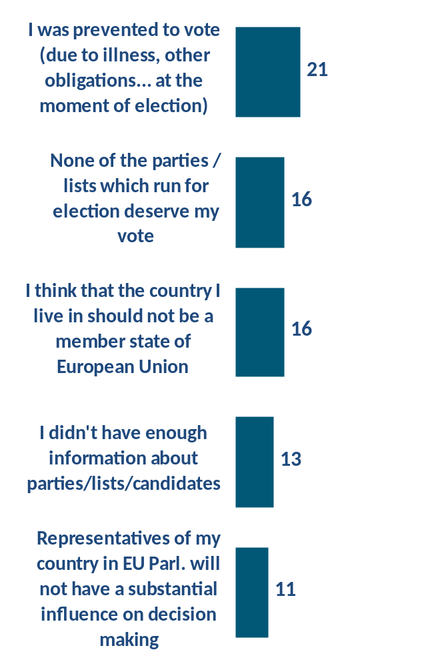
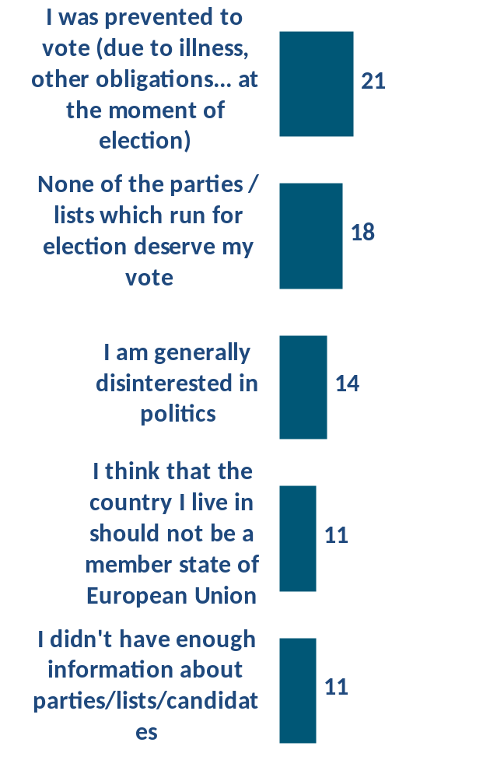
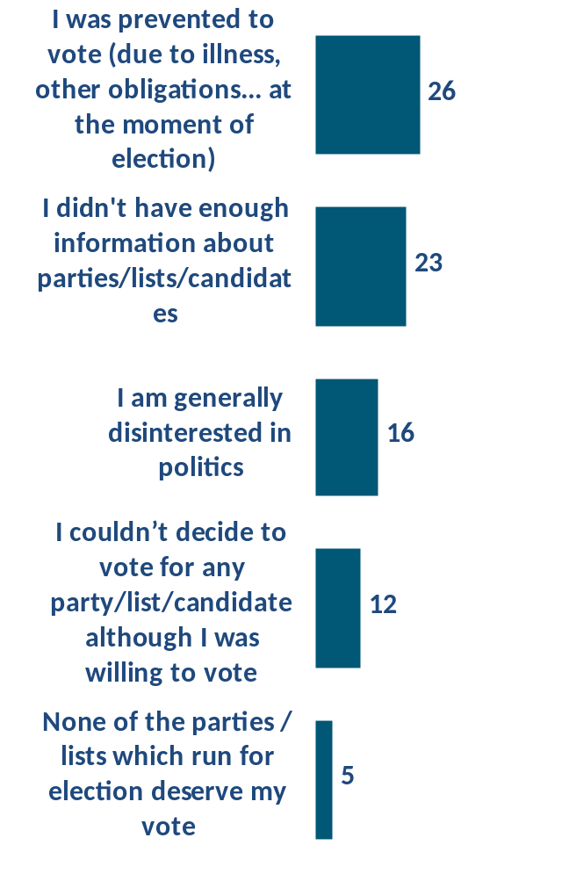
Which of the following reasons is the most important reason due to which you didn’t vote?
5 main reasons by countries
Austria
Croatia
Denmark
Base: Those who did not vote (56% of total population)

Slide 12
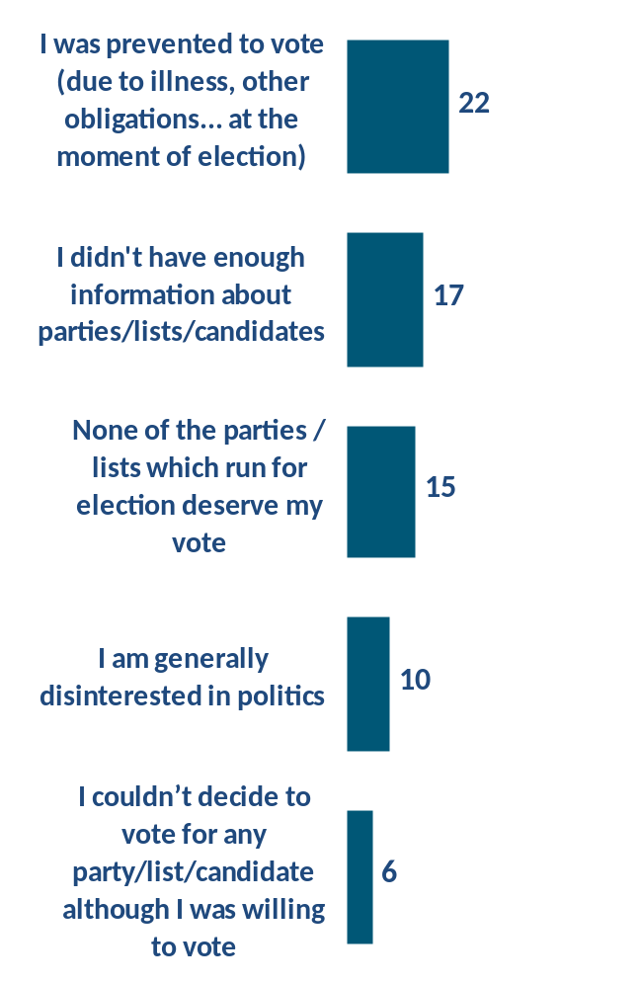
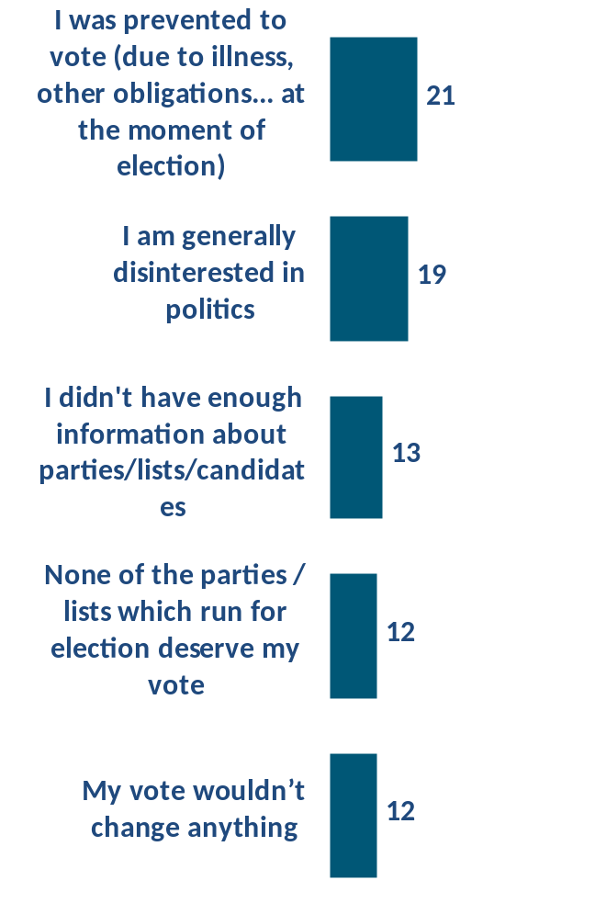
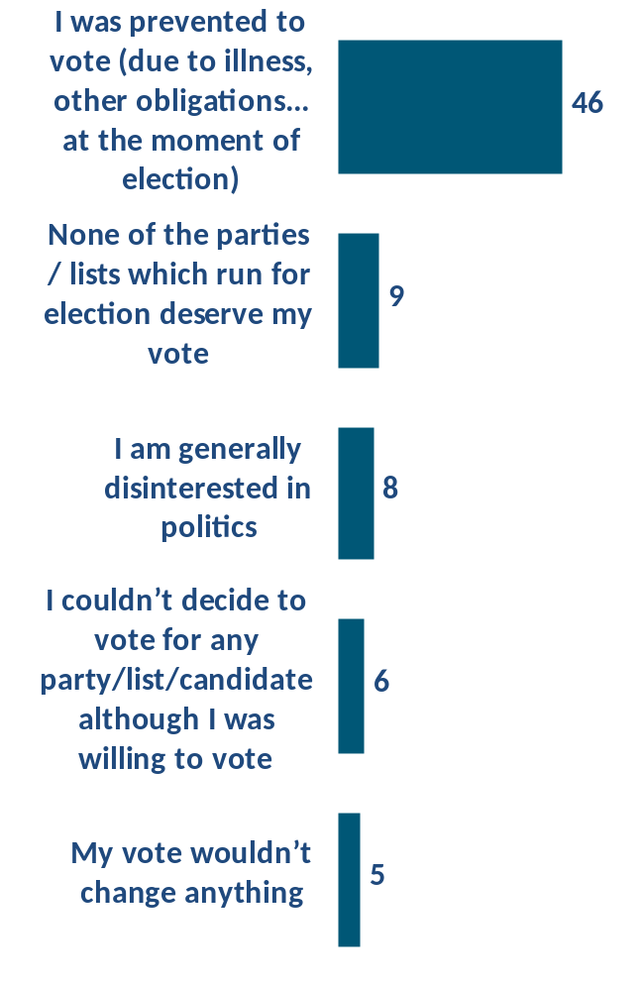
Which of the following reasons is the most important reason due to which you didn’t vote?
5 main reasons by countries
France
Germany
Greece
Base: Those who did not vote (56% of total population)

Slide 13
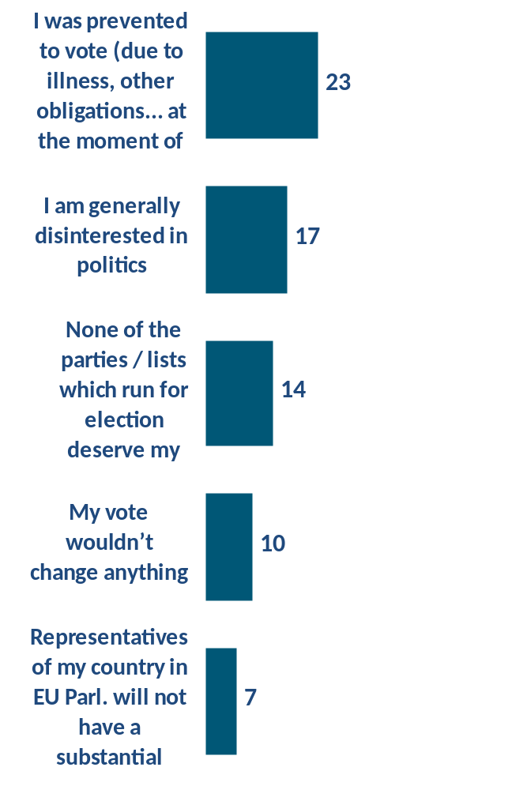
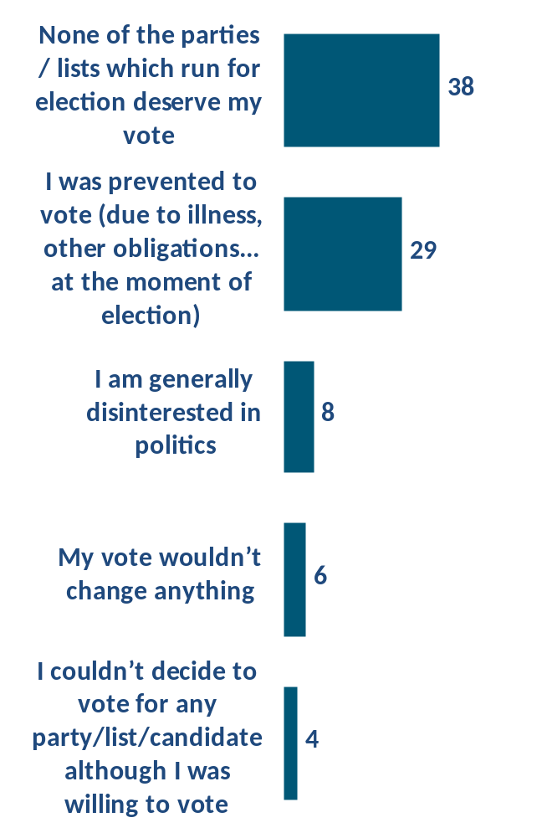
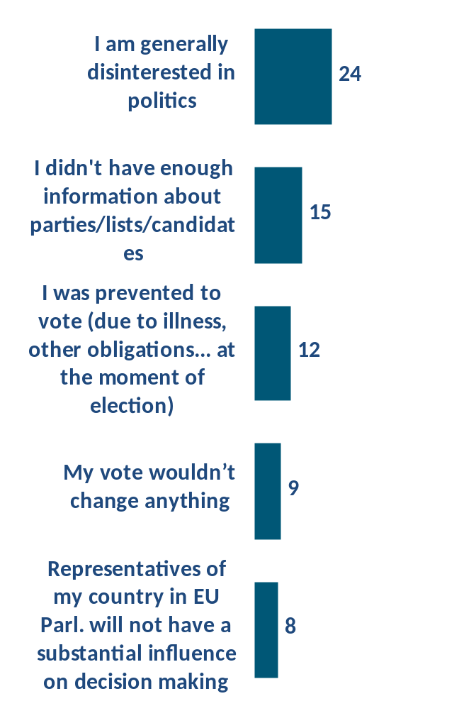
Which of the following reasons is the most important reason due to which you didn’t vote?
5 main reasons by countries
Hungary
Italy
Netherlands
Base: Those who did not vote (56% of total population)

Slide 14
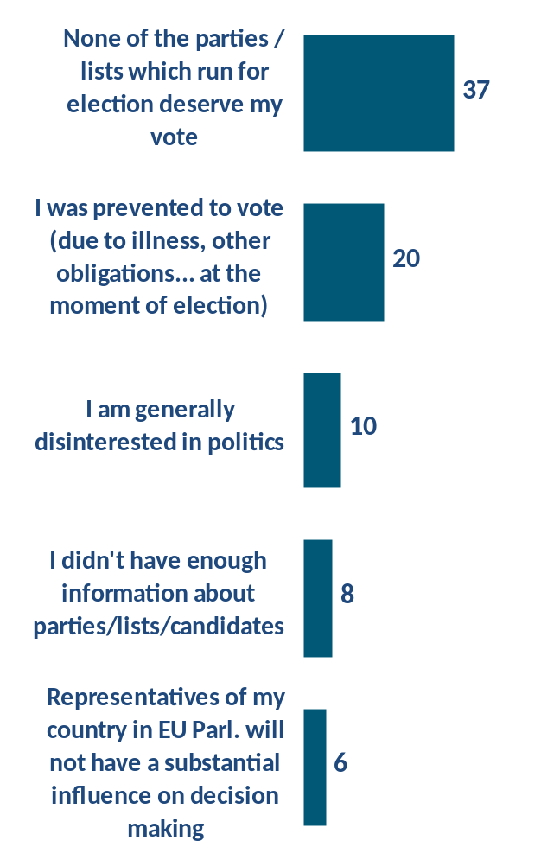
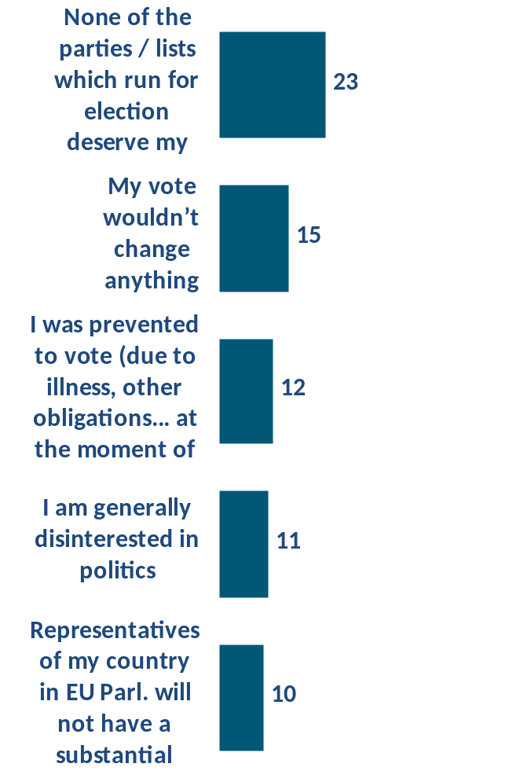
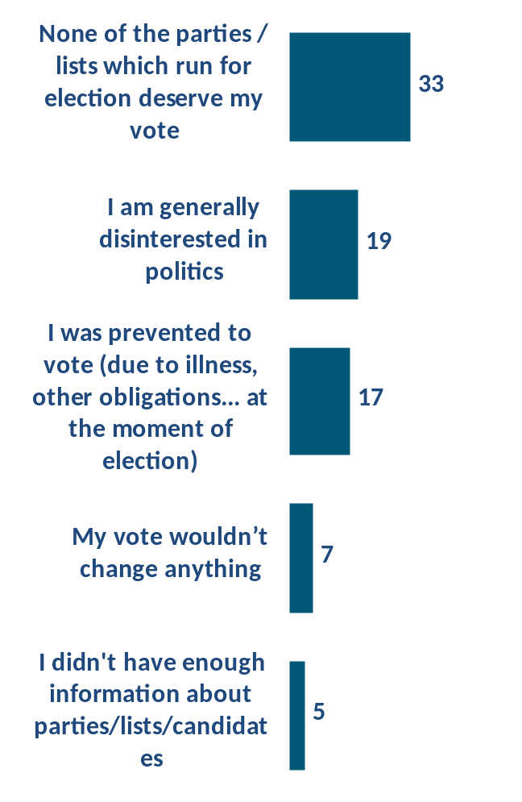
Which of the following reasons is the most important reason due to which you didn’t vote?
5 main reasons by countries
Which of the following reasons is the most important reason due to which you didn’t vote?
Poland
Romania
Spain
Base: Those who did not vote (56% of total population)

Slide 15
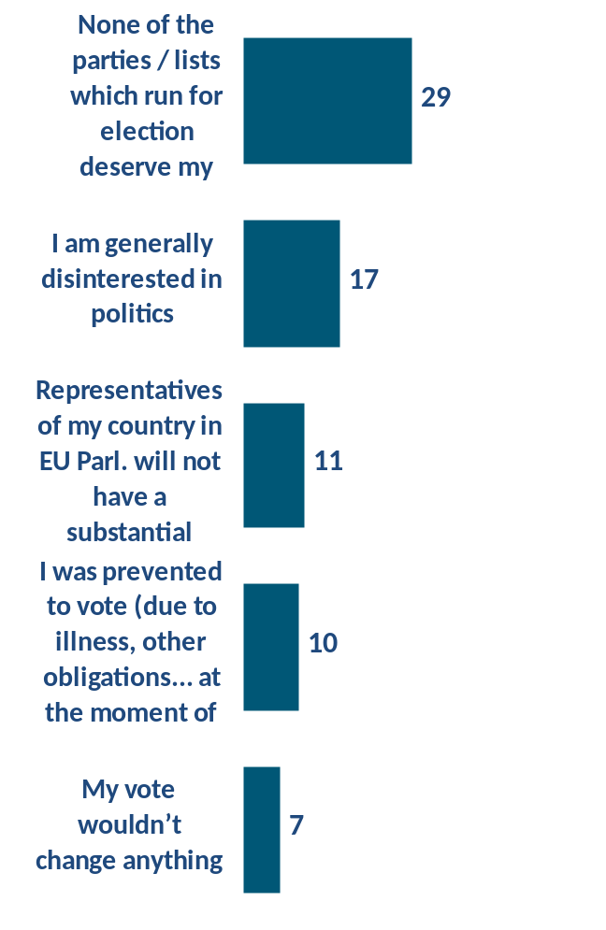
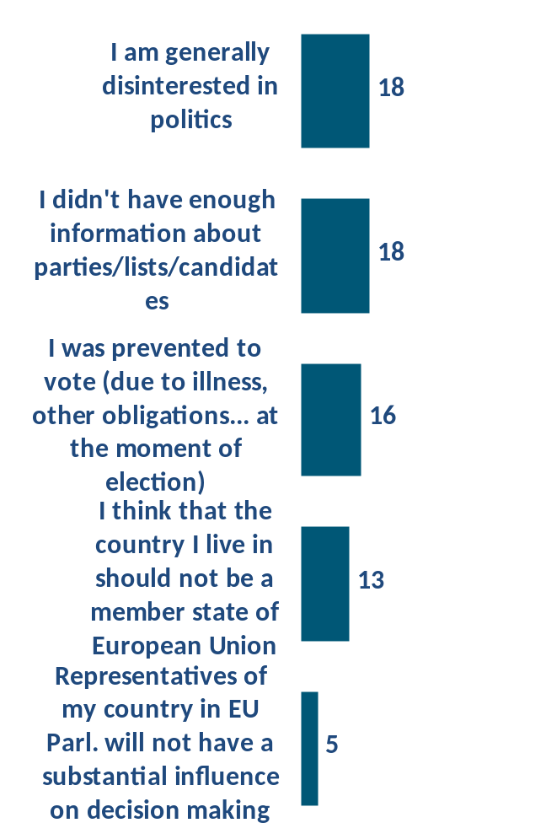
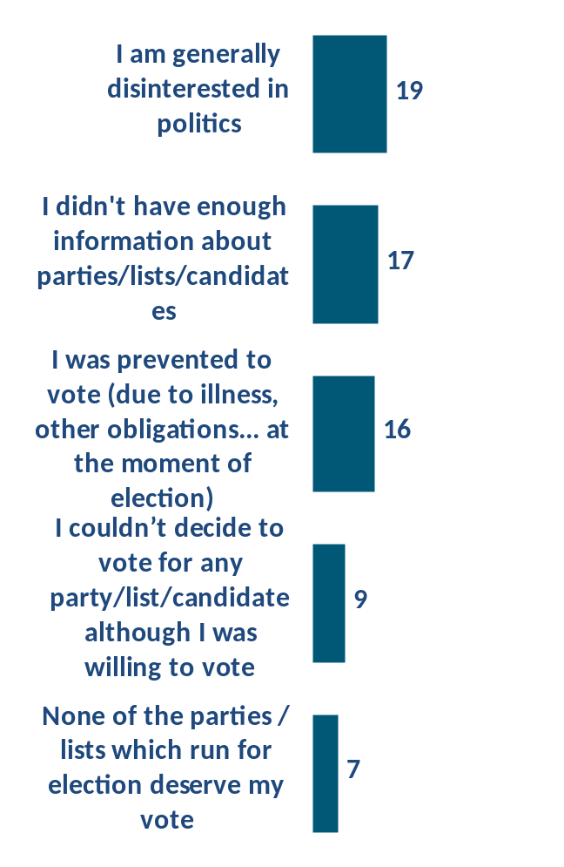
Which of the following reasons is the most important reason due to which you didn’t vote?
5 main reasons by countries
Slovenia
Sweden
UK
Base: Those who did not vote (56% of total population)

Slide 16
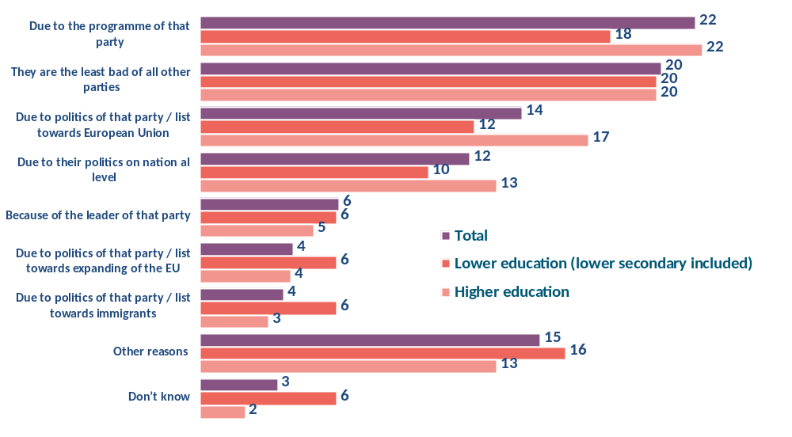
What was the main reason why you decided to vote for that particular party / list for European Parliament?
Base: Those who voted (44% of total population)

Slide 17
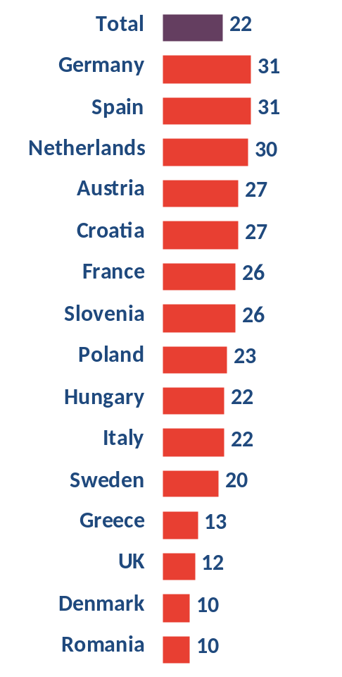
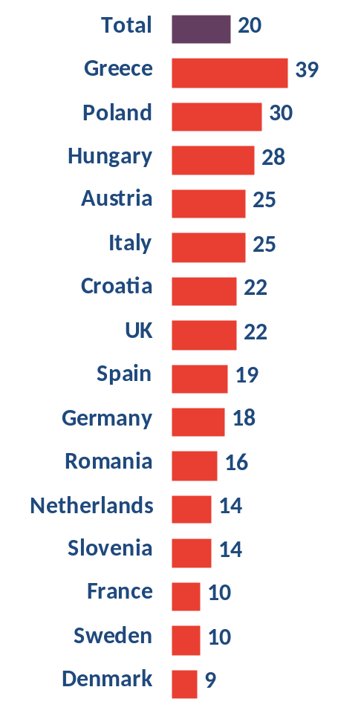
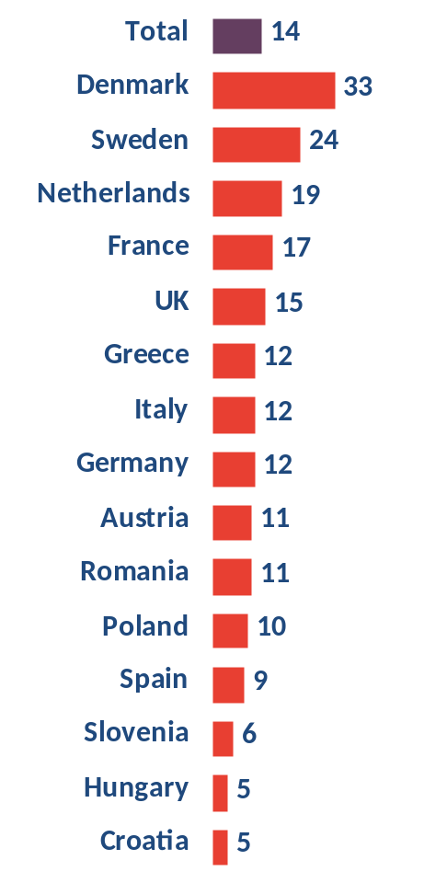
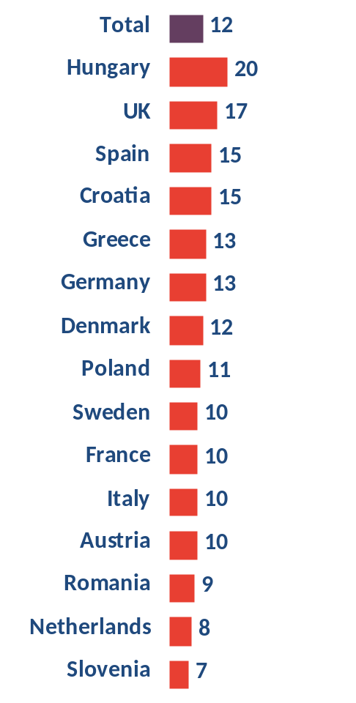
What was the main reason why you decided to vote for that particular party / list for European Parliament?
By reason
Due to the programme of that party
They are the least bad of all other parties
Due to politics of that party / list towards European Union
Due to their politics on nation al level
Base: Those who did not vote (56% of total population)

Slide 18
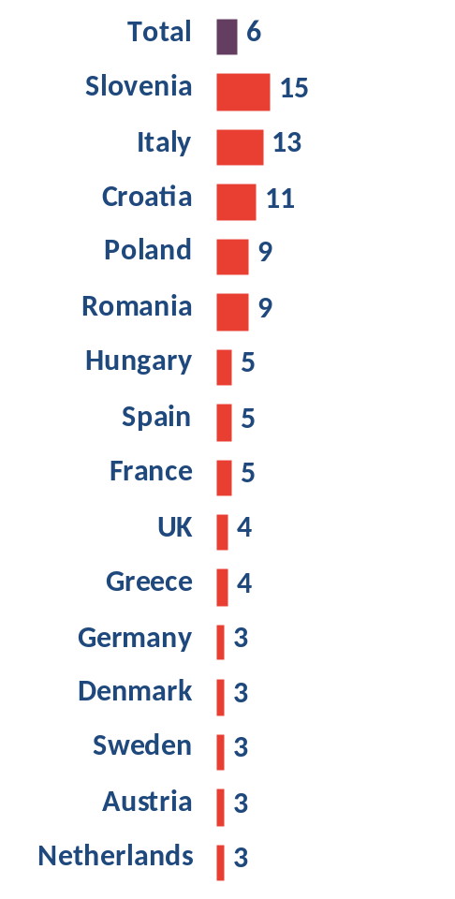
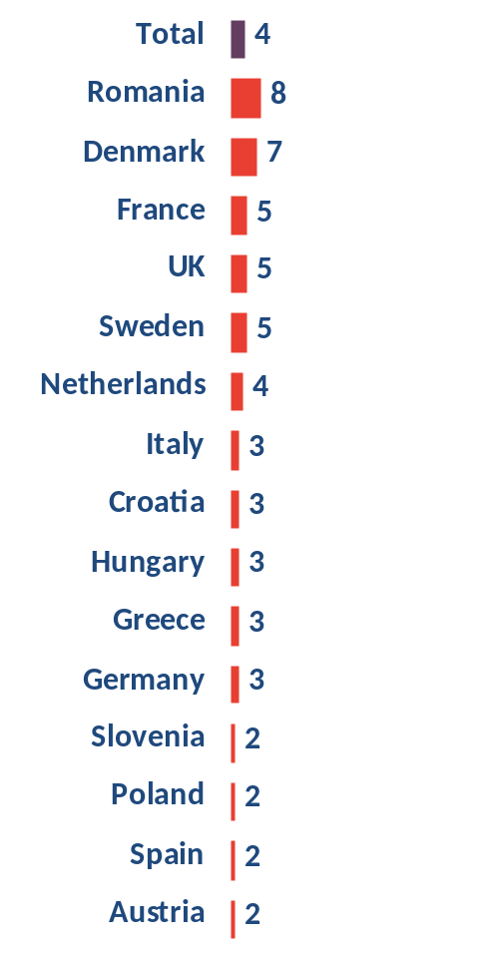
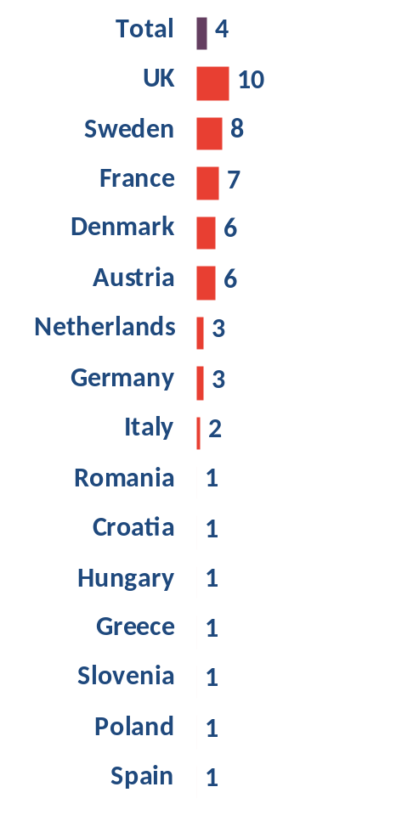
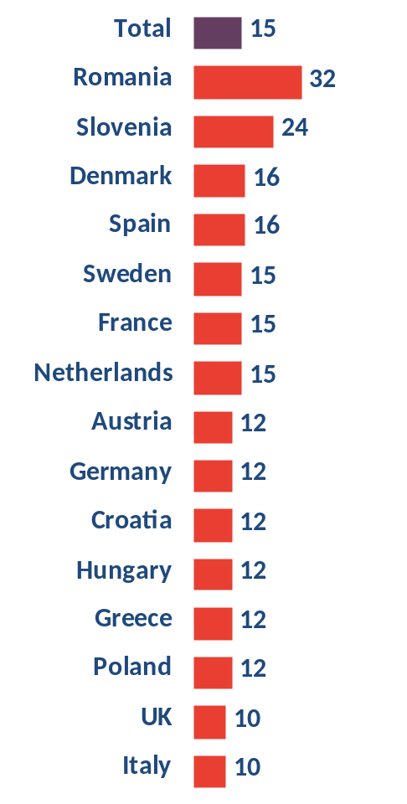
What was the main reason why you decided to vote for that particular party / list for European Parliament?
By reason
Because of the leader of that party
Due to politics of that party / list towards expanding of the EU
Due to politics of that party / list towards immigrants
Other reasons
Base: Those who did not vote (56% of total population)

Slide 19
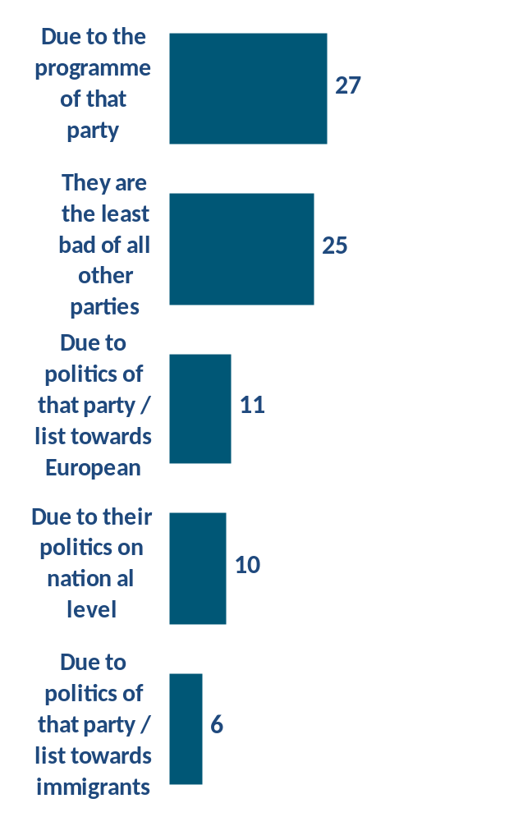
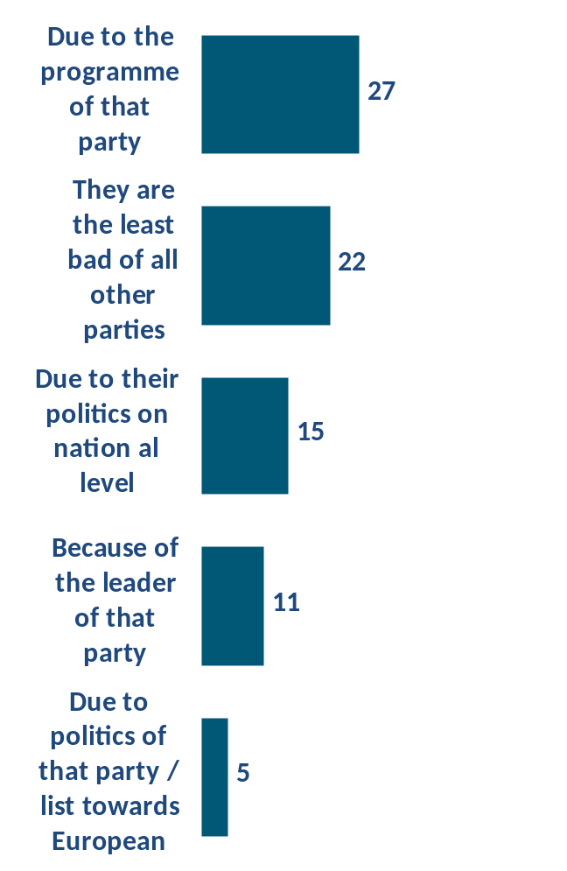
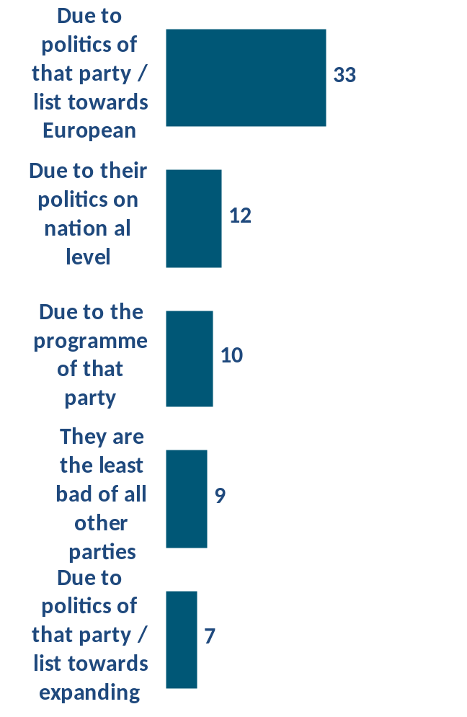
What was the main reason why you decided to vote for that particular party / list for European Parliament?
5 main reasons by countries
Austria
Croatia
Denmark
Base: Those who did not vote (56% of total population)

Slide 20
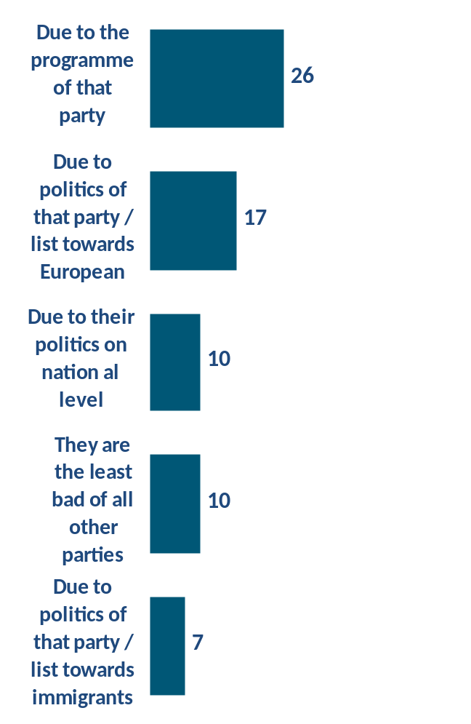
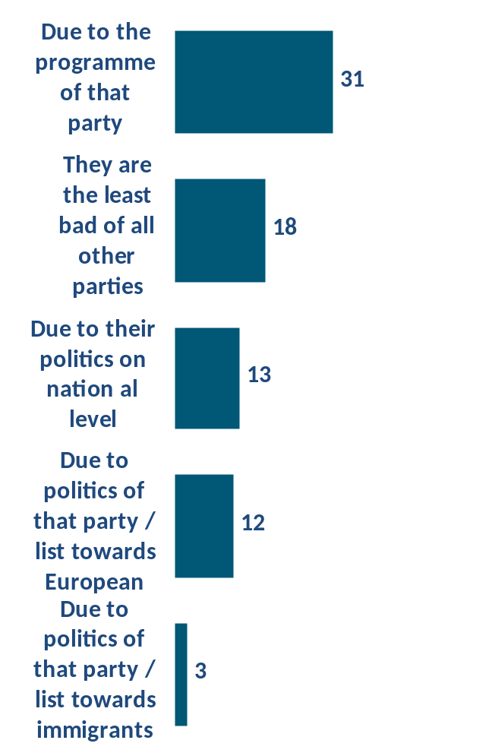
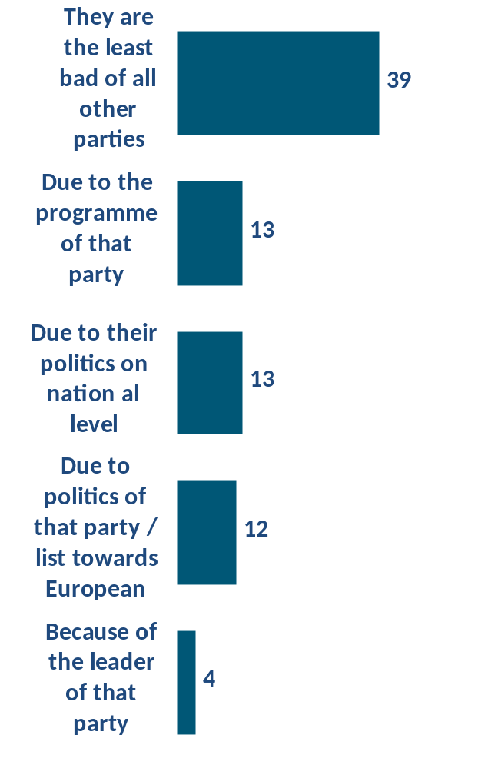
What was the main reason why you decided to vote for that particular party / list for European Parliament?
5 main reasons by countries
France
Germany
Greece
Base: Those who did not vote (56% of total population)

Slide 21
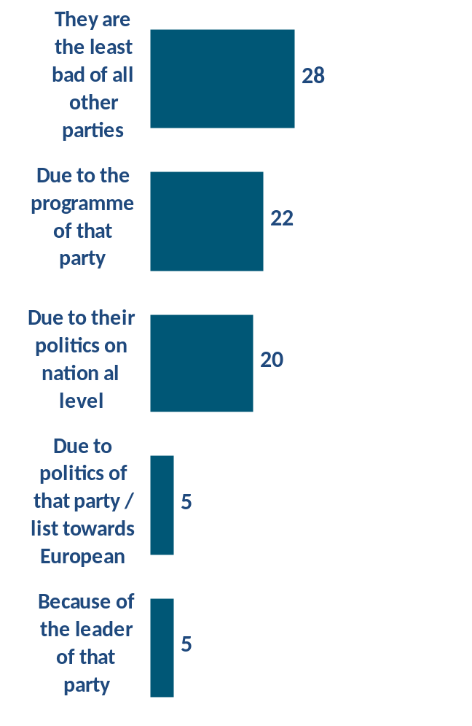
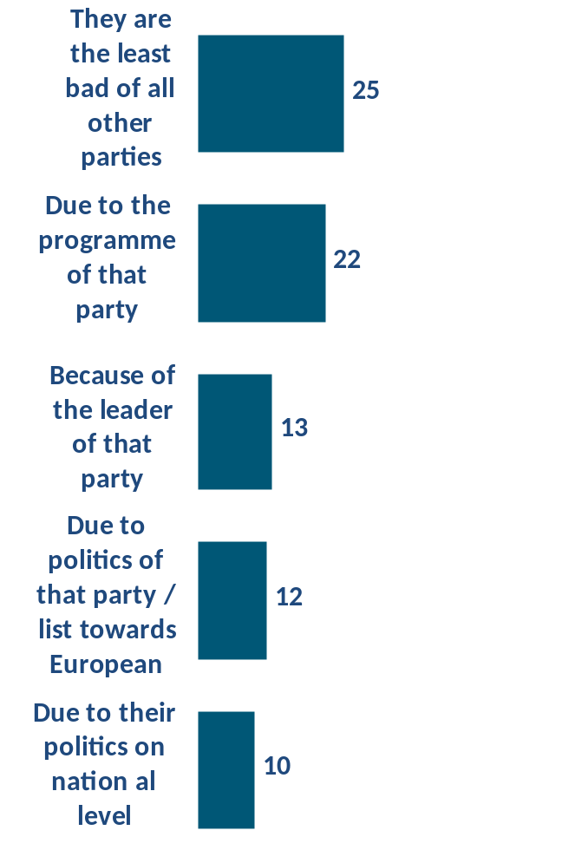
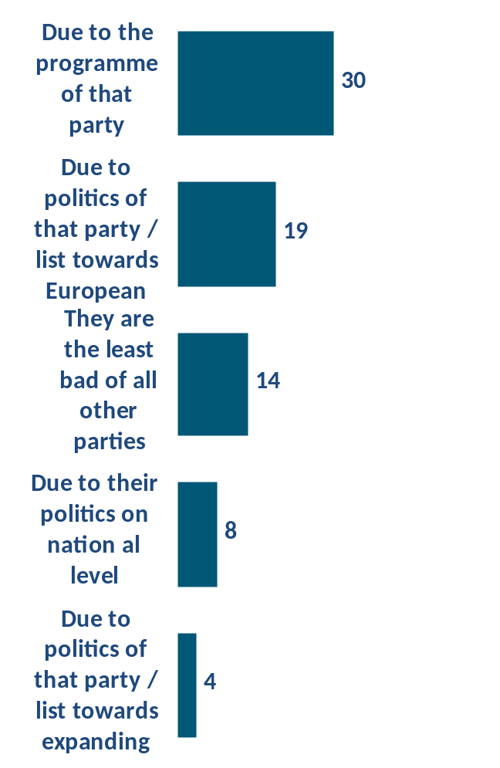
What was the main reason why you decided to vote for that particular party / list for European Parliament?
5 main reasons by countries
What was the main reason why you decided to vote for that particular party / list for European Parliament?
Hungary
Italy
Netherlands
Base: Those who did not vote (56% of total population)

Slide 22
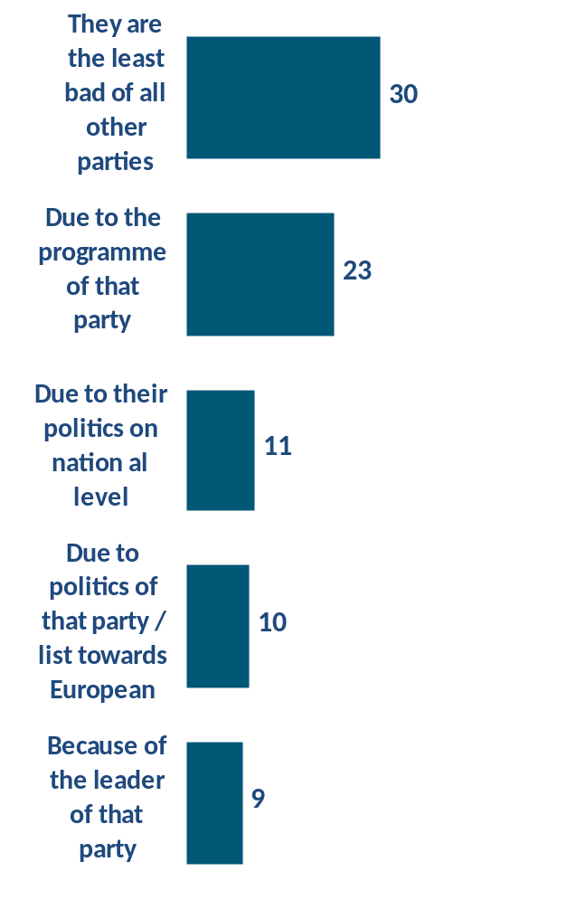
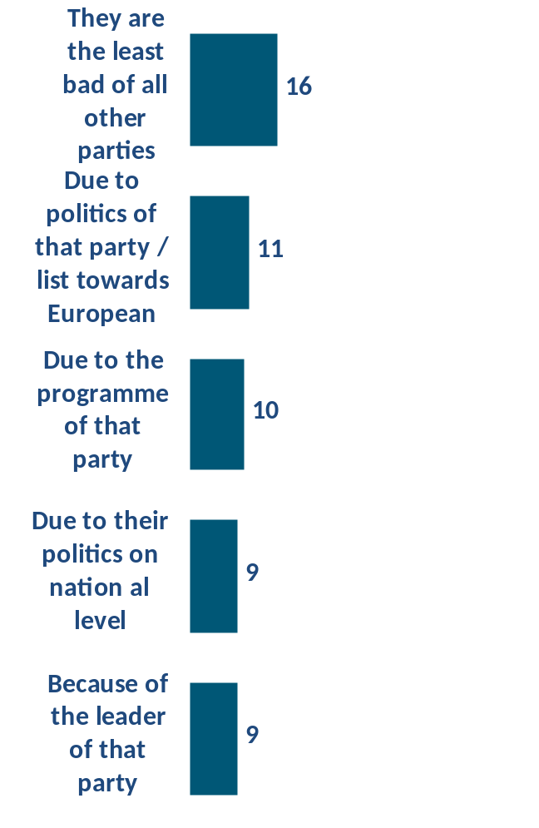
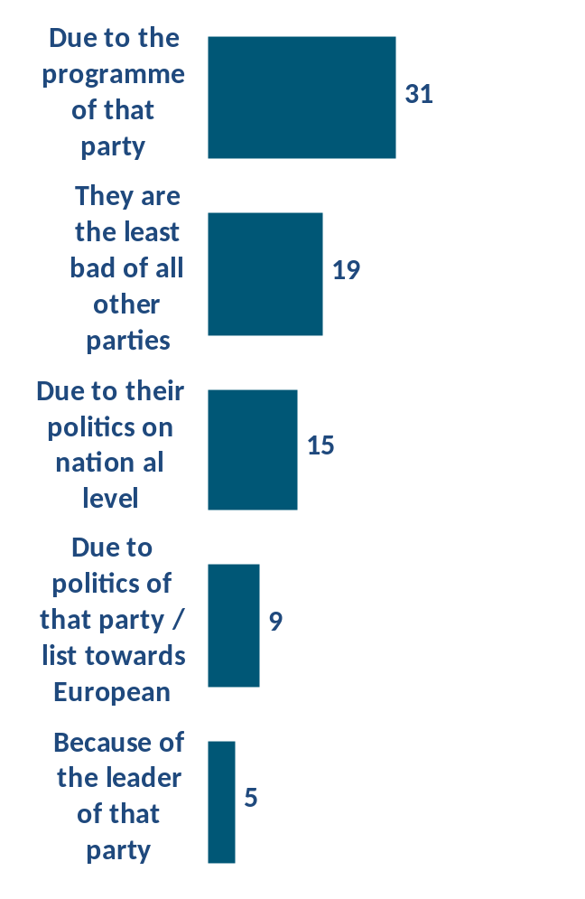
What was the main reason why you decided to vote for that particular party / list for European Parliament?
5 main reasons by countries
Poland
Romania
Spain
Base: Those who did not vote (56% of total population)

Slide 23
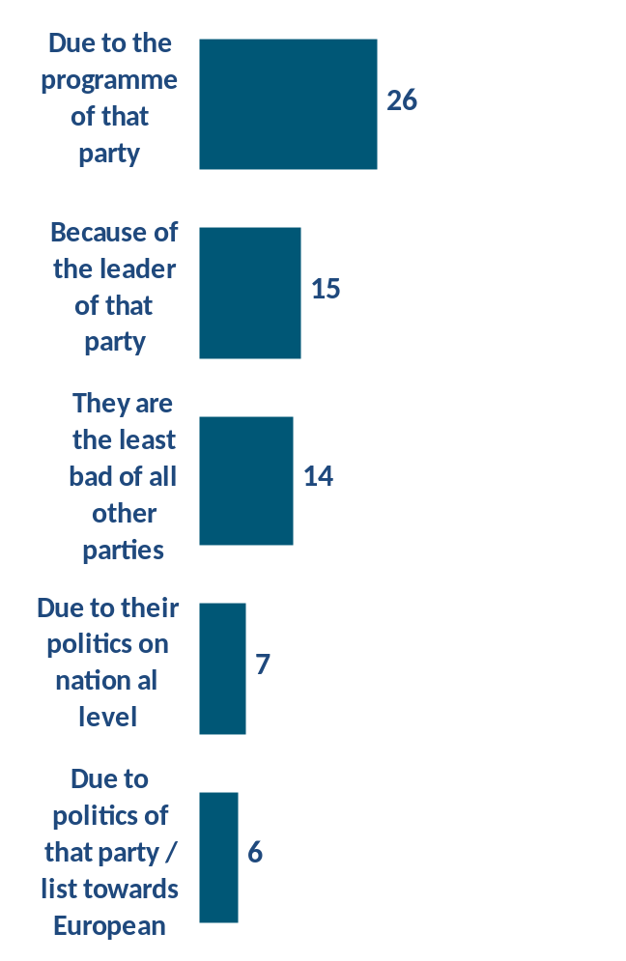
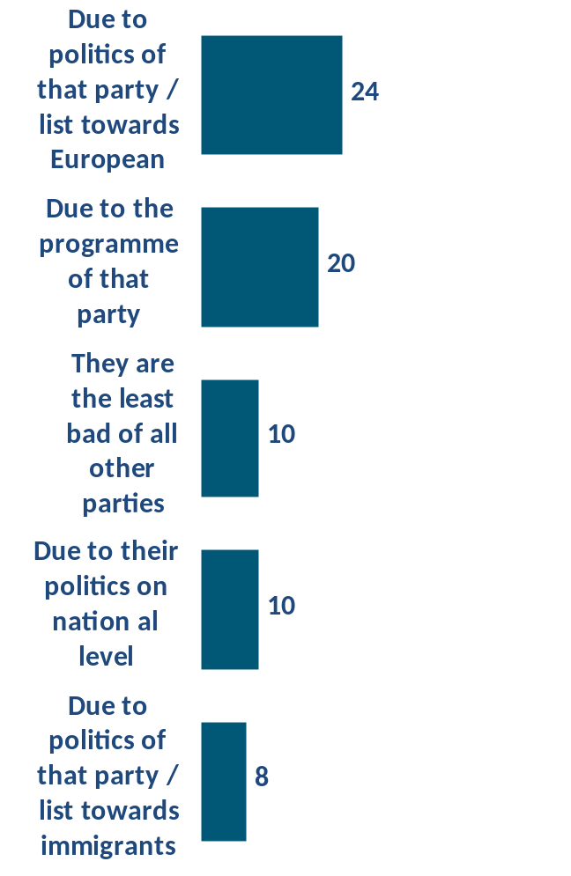
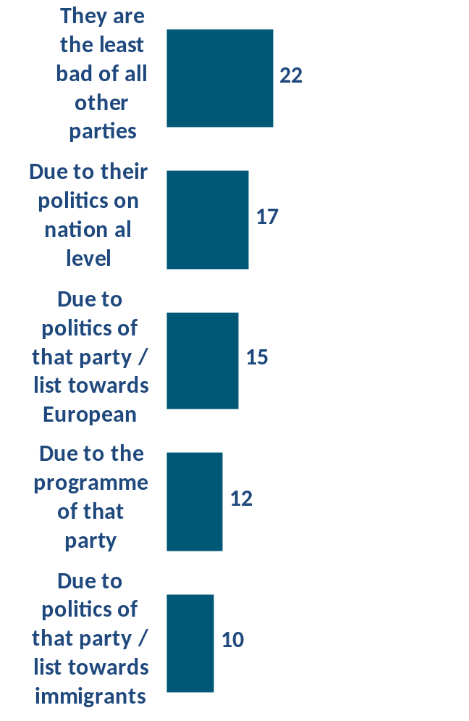
What was the main reason why you decided to vote for that particular party / list for European Parliament?
5 main reasons by countries
Slovenia
Sweden
UK
Base: Those who did not vote (56% of total population)

Slide 24

What was the main reason why you decided to vote for that particular party / list for European Parliament?
Base: Those who voted (44% of total population)

Slide 25

What was the main reason why you decided to vote for that particular party / list for European Parliament?
Base: Those who voted (44% of total population)

Slide 26
WHY PEOPLE DIDN’T VOTE?
People who didn’t vote most often claim that they didn’t do it because they were prevented (19.5%), they didn’t find any party / list they would support (18.6%) or they are not interested in politics (15%).
It is very important to note that for almost 20% of all people who didn’t vote as a single most important reason is lack of acceptable political options they would support.
Lack of information is most important reason for app. 12% of people, and belief that they couldn’t influence European politics is the reason of app. 13.5% EU citizens.
Women are less informed in general and more often were prevented to vote than males. Males more often claim that there is no party they would support. People with higher education level as well as those living in big cities more often claim they were prevented to vote, while people with lower education, living in rural areas or small towns are less interested in politics and didn’t vote.

Slide 27
WHY PEOPLE OPT FOR THE PARTY?
Pure political reasons are most often mentioned as most important for voting for certain political party – more than 60% of voters from these 15 countries claim that program of the party (21.7%), politics towards EU (14.1%), politics on national level (11.8%), politics towards expanding of EU (4.1%) and politics towards immigrants (3.7%) are key factors for support.
Hence, 20% of voters opt for the party because that party are the least bad of all other parties. This reason is more often mentioned in countries such as Greece (39%), Spain (31%), Poland (30%), Hungary (28%), Italy and Austria (25% each). In countries such as Austria, Sweden, Denmark, France and UK politics towards immigrants is more important than in other countries.
ECR, EFD and NI supporters more often vote because of their politics toward immigrants (8%, 11% and 14% respectively, compared to 4% on total), politics towards EU is more important for voters of ALDE, ECR and G/EFA (24%, 22% and 19% respectively, compared to 14% on total), while program of the party is the main reason for supporters of G/EFA and GUE/NGL (31% and 33% respectively, compared to 22% on total).

Slide 28

When did you make the decision about the party/list that you would vote for?
Gender
Education
Base: Those who voted (44% of total population)

Slide 29

When did you make the decision about the party/list that you would vote for?
Base: Those who voted (44% of total population)

Slide 30

When did you make the decision about the party/list that you would vote for?
Base: Those who voted (44% of total population)

Slide 31
WHEN THEY DECIDED WHO TO VOTE?
Almost half of all voters made decision in last seven days prior to election (46%) – among them, almost 20% decided directly on the polling place (18.6%). Only ¼ of all voters vote for the party they usually support (26.6%).
People with lower education and those living in rural areas or small towns more often made a decision directly on the polling place.

Slide 32

During the electoral campaign for European Parliament did you maybe change the initial decision about the party/list that you would vote for?
Education
Base: Those who voted (44% of total population)

Slide 33

During the electoral campaign for European Parliament did you maybe change the initial decision about the party/list that you would vote for?
Base: Those who voted (44% of total population)

Slide 34

During the electoral campaign for European Parliament did you maybe change the initial decision about the party/list that you would vote for?
Base: Those who voted (44% of total population)

Slide 35

During the electoral campaign for European Parliament did you maybe change the initial decision about the party/list that you would vote for?
Gender
Education
Base: Total population – Citizens aged 18-39 from 15 EU countries

Slide 36

During the electoral campaign for European Parliament did you maybe change the initial decision on whether you would vote or not?
Base: Total population – Citizens aged 18-39 from 15 EU countries

Slide 37

During the electoral campaign for European Parliament did you maybe change the initial decision on whether you would vote or not?
Base: Total population – Citizens aged 18-39 from 15 EU countries

Slide 38
DID THEY CHANGE THEIR OPINION DURING CAMPAIGN?
64% of those who voted didn’t change their opinion during campaign. ¼ of voters didn’t know who to support prior to the campaign, but then made up their mind during campaign. 12% changed their mind and switched to another party during the campaign. According to these data, it seems that most successful campaigns had ALDE, G/EFA and GUE/NGL, since they succeeded to attract significantly more undecided voters during the campaign than parties from other groups.
Almost 80% of people didn’t change their mind whether to vote or not during the campaign; 12.5% of people decided not to vote, while 9% decided to vote. Among those who supported EFD and EPP are more of them decided to vote during the campaign.

Slide 39

Did the electoral campaign for European Parliament increase the extent of your knowledge about...
Base: Total population – Citizens aged 18-39 from 15 EU countries

Slide 40

Did the electoral campaign for European Parliament increase the extent of your knowledge about European Union in general
Education
Gender
Base: Total population – Citizens aged 18-39 from 15 EU countries

Slide 41

Did the electoral campaign for European Parliament increase the extent of your knowledge about European Union in general
Base: Total population – Citizens aged 18-39 from 15 EU countries

Slide 42

Did the electoral campaign for European Parliament increase the extent of your knowledge about European Union in general
Base: Total population – Citizens aged 18-39 from 15 EU countries

Slide 43

Did the electoral campaign for European Parliament increase the extent of your knowledge about Elections for European Parliament
Education
Gender
Base: Total population – Citizens aged 18-39 from 15 EU countries

Slide 44

Did the electoral campaign for European Parliament increase the extent of your knowledge about Elections for European Parliament
Did the electoral campaign for European Parliament increase the extent of your knowledge about Elections for European Parliament
Base: Total population – Citizens aged 18-39 from 15 EU countries

Slide 45

Did the electoral campaign for European Parliament increase the extent of your knowledge about Elections for European Parliament
Base: Total population – Citizens aged 18-39 from 15 EU countries

Slide 46

Did the electoral campaign for European Parliament increase the extent of your knowledge about EU institutions
Education
Gender
Base: Total population – Citizens aged 18-39 from 15 EU countries

Slide 47

Did the electoral campaign for European Parliament increase the extent of your knowledge about EU institutions
Did the electoral campaign for European Parliament increase the extent of your knowledge about EU institutions
Base: Total population – Citizens aged 18-39 from 15 EU countries

Slide 48

Did the electoral campaign for European Parliament increase the extent of your knowledge about EU institutions
Base: Total population – Citizens aged 18-39 from 15 EU countries

Slide 49
DID CAMPAIGN INCREASED KNOWLEDGE ABOUT EU?
More than 50% of people claim that campaign didn’t increase their knowledge about EU, EU elections and EU institutions at all (55.7%, 51.6% and 58.7% respectively). In average, 15-20% people think that electoral campaign increased their knowledge about EU, elections and institutions. This is strongly connected with voting behavior – those who voted were involved in elections to greater extent and learned more about EU, their institutions and elections during the campaign than those who didn’t vote.
People from Italy, Greece, Romania, Denmark and Sweden more often claimed they increased their knowledge during the campaign.

Slide 50

Please think for a moment about your political orientation. If you had to define yourself on the scale from 1 to 10, where 1 means that you support the extreme leftist ideas, and 10 means that you support the extreme rightist ideas, on which step do you think that you currently are?
Gender
Education
Base: Total population – Citizens aged 18-39 from 15 EU countries

Slide 51

Please think for a moment about your political orientation. If you had to define yourself on the scale from 1 to 10, where 1 means that you support the extreme leftist ideas, and 10 means that you support the extreme rightist ideas, on which step do you think that you currently are?
RIGHT (sum 6 to 10)
○ | Right (sum 8 to 10)
○ | Right center (sum 6 to 7)
○ | Left center (sum 4 to 5)
○ | Left (sum 1 to 3)
LEFT (sum 1 to 5)
Base: Total population – Citizens aged 18-39 from 15 EU countries

Slide 52

Please think for a moment about your political orientation. If you had to define yourself on the scale from 1 to 10, where 1 means that you support the extreme leftist ideas, and 10 means that you support the extreme rightist ideas, on which step do you think that you currently are?
○ | Right (sum 8 to 10) | ○ | Right center (sum 6 to 7) | ○ | Left center (sum 4 to 5) | ○ | Left (sum 1 to 3)
RIGHT (sum 6 to 10) |  |  |  |  |  | LEFT (sum 1 to 5)
Base: Total population – Citizens aged 18-39 from 15 EU countries

Slide 53

Please think for a moment about your political orientation. If you had to define yourself on the scale from 1 to 10, where 1 means that you support the extreme leftist ideas, and 10 means that you support the extreme rightist ideas, on which step do you think that you currently are?
RIGHT (sum 6 to 10)
○ | Right (sum 8 to 10)
○ | Right center (sum 6 to 7)
○ | Left center (sum 4 to 5)
○ | Left (sum 1 to 3)
LEFT (sum 1 to 5)
Base: Total population – Citizens aged 18-39 from 15 EU countries

Slide 54

Do you consider yourself...
Gender
Education
Base: Total population – Citizens aged 18-39 from 15 EU countries

Slide 55

Do you consider yourself...
Base: Total population – Citizens aged 18-39 from 15 EU countries

Slide 56

Do you consider yourself...
Base: Total population – Citizens aged 18-39 from 15 EU countries

Slide 57
HOW DO THEY PERCEIVE THEMSELVES?
Most people consider themselves primary the citizens of the country they live in (47%). Slightly over 10% of people living in 15 EU countries claim they are primarily citizens of Europe (11%) and about ¼ perceive themselves as members of their nation (24%).
That they are primarily citizens of Europe claim more people living in Poland (19%), Romania (17%), Italy (16%), France (14%) and Germany (14%). Citizens of Denmark (58%), Poland (45%), Netherlands (43%), and Hungary (35%) perceive themselves as a member of the nation more often than European average. Stronger identification with the country they live in is a characteristic of 67% citizens of Romania, 64% of Sweden, 62% of Austria, 56% of UK.
Voters of S&D (18%), EPP (18%), G/EFA (17%) and ALDE (15%) more often identify themselves as citizens of Europe than on total (11%). ECR (46%), ALDE (34%) and EPP (20%) supporters more often identify themselves as members of their nation.

Slide 58

People have different opinions on the European Union... Which of the following statements is closest to your opinion?
Gender
Education
Base: Total population – Citizens aged 18-39 from 15 EU countries

Slide 59

People have different opinions on the European Union... Which of the following statements is closest to your opinion?
Base: Total population – Citizens aged 18-39 from 15 EU countries

Slide 60

People have different opinions on the European Union... Which of the following statements is closest to your opinion?
Base: Total population – Citizens aged 18-39 from 15 EU countries

Slide 61

In your opinion, what will happen with the European Union in the future?
Gender
Education
Base: Total population – Citizens aged 18-39 from 15 EU countries

Slide 62

In your opinion, what will happen with the European Union in the future?
Base: Total population – Citizens aged 18-39 from 15 EU countries

Slide 63

In your opinion, what will happen with the European Union in the future?
Base: Total population – Citizens aged 18-39 from 15 EU countries

Slide 64

In your opinion, for how long will the European Union survive
Gender
Education
Base: Total population – Citizens aged 18-39 from 15 EU countries

Slide 65

In your opinion, for how long will the European Union survive
Base: Total population – Citizens aged 18-39 from 15 EU countries

Slide 66

In your opinion, for how long will the European Union survive
Base: Total population – Citizens aged 18-39 from 15 EU countries

Slide 67
OPINION ON THE EU? (1)
17.4% of people living in 15 EU countries believe EU is a very bad option for the country they live in; this is an attitude of 34% of Slovenians, 25% of Austrians and Croats, 23% of Italians.
Moreover, 22% of EU citizens believe EU is necessary evil they accept because of the lack of other ideas. In total, there is 40% of citizens who think EU is not a good option for themselves and country they live in. Less than 1/3 of people from 15 countries covered in the survey have positive attitude towards EU and believe EU offers great opportunities to its citizens.
Positive attitudes are more often characteristic of people living in Romania (58%), Poland (42%), Hungary (37%) and Greece (37%), as well as for people with higher education, those living in big cities and voters of EPP (52%), ALDE (50%), S&D (49%) and G/EFA (46%). Euro skepticism is more often characteristic of NI, EFD and ECR voters (44%, 44% and 28% respectively).
More than ¼ of citizens of 15 countries do not know what will happen with EU in the future. 16.5% of EU citizens believe EU will not survive, and 16% believe EU will be more integrated and at service of its citizens. People living in Romania, Italy, Poland and France more often believe in bright future of the EU, as well as people with higher education, those living in big cities and voters of EPP (33%), S&D (30%), ALDE (25%) and G/EFA (23%).

Slide 68
OPINION ON THE EU? (2)
People living in Croatia (37%), Slovenia (29%), Poland (25%), Greece (22%) and Hungary (21%) are more often to believe EU will not survive than EU average (16.5%).
Citizens of Sweden (43%), UK (38%), Netherlands (35%), Spain (34%), France (31%) and Germany (31%) are unsure about the future of EU, as well as voters of NI (32%) and EFD (24%).
30% of people do not know for how long EU will survive, and almost 1/3 believe EU will last longer than 20 years. Most pessimistic about EU future are those who believe EU will survive up to five years – 6.7% in total. Euro skepticism is more often characteristic of people with lower education and those living in villages and small towns, citizens of Greece, Italy, Slovenia and UK and voters of NI and GUE/NGL. Positive expectations about EU future have people with higher education and from big cities, as well as citizens of Denmark, Romania and Germany and voters of ALDE, G/EFA, EPP and S&D.

Slide 69

In your opinion, would the European Union be better or worse if something of the following happened?
If there were less immigrants in the country you live in
If LGBT persons would not be given all the rights other citizens have
Gender
Education
Base: Total population – Citizens aged 18-39 from 15 EU countries

Slide 70


In your opinion, would the European Union be better or worse if something of the following happened?
If there were less immigrants in the country you live in
If LGBT persons would not be given all the rights other citizens have
Base: Total population – Citizens aged 18-39 from 15 EU countries

Slide 71
















In your opinion, would the European Union be better or worse if something of the following happened?
Ø 17,6
Denmark
LGBT+ IMMIGRANTS -
LGBT+ IMMIGRANTS +
Netherlands
Spain
Germany
Sweden
UK
Austria
Ø 42,4
Hungary
Slovenia
Greece
The EU would be worse If LGBT persons would not be given all the rights other citizens have
Croatia
Italy
France
Poland
Romania
LGBT- IMMIGRANTS -
LGBT- IMMIGRANTS +
The EU would be worse If there were less immigrants in the country you live in
Base: Total population – Citizens aged 18-39 from 15 EU countries

Slide 72


In your opinion, would the European Union be better or worse if something of the following happened?
If there were less immigrants in the country you live in
If LGBT persons would not be given all the rights other citizens have
Base: Total population – Citizens aged 18-39 from 15 EU countries

Slide 73

Friendly towards LGBT and immigrants

Slide 74

Friendly towards LGBT and immigrants

Slide 75

Unfriendly towards LGBT and immigrants

Slide 76

Unfriendly towards LGBT and immigrants

Slide 77
WHAT DO THEY THINK ABOUT IMMIGRANTS AND LGBT POPULATION?
Attitudes of 15 EU countries citizens towards immigrants are mostly negative – 39% believe EU would be better place for living if there were less immigrants, 18% believe it would be actually better place, and 43% do not have attitude on this issue.
Negative attitudes towards immigrants more often have males, people with lower education, living in villages and suburbs, citizens of Greece, Italy, Austria, France, voters of NI, EFD, ECR and EPP. EU would be worse place if there were less immigrants believe people with higher education, from big cities, living in Sweden, Spain, Romania, Germany and supporters of G/FA and GUE/NGL.
Attitudes towards LGBT persons are more positive than attitudes towards immigrants – 15% believe EU would be better place If LGBT persons would not be given all the rights other citizens have and 42% believe EU would be worse place to live under these circumstances. 43% do not have an opinion about this issue.
More positive attitudes, again, have females, person with higher education and those living in big cities, people living in Denmark, Spain, Netherlands, Sweden, Germany and Austria, as well as ALDE,G/EFA, GUE/NGL and S&D voters. Negative attitudes are characteristic of males, people living in Hungary, Italia and Romania, as well as voters of EFD, EPP and NI.

Slide 78
In your opinion, which of the following member states do not deserve to be a part of the European Union?
Base: Total population – Citizens aged 18-39 from 15 EU countries

Slide 79

In your opinion, which of the following member states do not deserve to be a part of the European Union?
Base: Total population – Citizens aged 18-39 from 15 EU countries

Slide 80





In your opinion, which of the following member states do not deserve to be a part of the European Union?
10 most frequently mentioned countries
Romania
Bulgaria
Greece
Slovakia
Slovenia
Base: Those who did not vote (56% of total population)

Slide 81





In your opinion, which of the following member states do not deserve to be a part of the European Union?
10 most frequently mentioned countries
Croatia
Hungary
Lithuania
Cyprus
Poland
Base: Those who did not vote (56% of total population)

Slide 82





In your opinion, which of the following member states do not deserve to be a part of the European Union?
Answers by countries: 10 most frequently mentioned
Austria
Croatia
Denmark
France
Germany
Base: Those who did not vote (56% of total population)

Slide 83





In your opinion, which of the following member states do not deserve to be a part of the European Union?
Answers by countries: 10 most frequently mentioned
Greece
Hungary
Italy
Netherlands
Poland
Base: Those who did not vote (56% of total population)

Slide 84





In your opinion, which of the following member states do not deserve to be a part of the European Union?
Answers by countries: 10 most frequently mentioned
Romania
Spain
Slovenia
Sweden
UK
Base: Those who did not vote (56% of total population)

Slide 85




In your opinion, which of the following member states do not deserve to be a part of the European Union?
Answers by votes: 10 most frequently mentioned
ALDE
ECR
EFD
EPP
Base: Those who did not vote (56% of total population)

Slide 86




In your opinion, which of the following member states do not deserve to be a part of the European Union?
Answers by votes: 10 most frequently mentioned
G/EFA
GUE/NGL
NI
S&D
Base: Those who did not vote (56% of total population)

Slide 87

Citizens of the European Union have different opinions on expanding the European Union. While some think that the process of integration can’t be finalized before all European countries that meet the conditions join in, others believe that the process of integration should be finalized and limited to the current member states. Which of these two opinion sis closer to your own?
Gender
Education
Base: Those who did not vote (56% of total population)

Slide 88

Citizens of the European Union have different opinions on expanding the European Union. While some think that the process of integration can’t be finalized before all European countries that meet the conditions join in, others believe that the process of integration should be finalized and limited to the current member states. Which of these two opinion sis closer to your own?
Base: Those who did not vote (56% of total population)

Slide 89

Citizens of the European Union have different opinions on expanding the European Union. While some think that the process of integration can’t be finalized before all European countries that meet the conditions join in, others believe that the process of integration should be finalized and limited to the current member states. Which of these two opinion sis closer to your own?
Base: Those who did not vote (56% of total population)

Slide 90

If the country you live in would not be a member of the European Union, would you think that citizens of your country would live a lot better than now, somewhat better than now, same as now, somewhat worse than now, a lot worse than now?
Gender
Education
Base: Those who did not vote (56% of total population)

Slide 91

If the country you live in would not be a member of the European Union, would you think that citizens of your country would live a lot better than now, somewhat better than now, same as now, somewhat worse than now, a lot worse than now?
Base: Those who did not vote (56% of total population)

Slide 92

If the country you live in would not be a member of the European Union, would you think that citizens of your country would live a lot better than now, somewhat better than now, same as now, somewhat worse than now, a lot worse than now?
Base: Those who did not vote (56% of total population)

Slide 93

Considering quality of life in the country you live in, do you think that citizens of your country have a better, worse or the same life as citizens of most other EU member states?
Gender
Education
Base: Those who did not vote (56% of total population)

Slide 94

Considering quality of life in the country you live in, do you think that citizens of your country have a better, worse or the same life as citizens of most other EU member states?
Base: Those who did not vote (56% of total population)

Slide 95

Considering quality of life in the country you live in, do you think that citizens of your country have a better, worse or the same life as citizens of most other EU member states?
Base: Those who did not vote (56% of total population)

Slide 96

The current quality of life and future outside EU
Ø 42,8
Good life and better outside EU
Bad life and better outside EU
Slovenia
Greece
Austria
Italy
The citizens would live a lot better than now If the country they live in would not be a member of the European Union
Sweden
Netherlands
Ø 35,1
Germany
Spain
Romania
France
Hungary
Denmark
Poland
UK
Croatia
God life but not better outside EU
Bad life but not better outside EU
The citizens of my country have a worse life as citizens of most other EU member states
Base: Total population – Citizens aged 18-39 from 15 EU countries

Slide 97
EU MEMBER STATES IN THE FUTRE (1)
People of 15 EU countries covered by the survey most often point out Romania (19%), Bulgaria (12%) and Greece (11%) as countries that shouldn’t be EU member states. It’s interesting that people living in Greece most often mention that Germany and UK shouldn’t be member states.
Almost 40% of EU citizens think that integration can’t be finalized before all European countries join EU, while app. ¼ of them think that integration process should be finalized and limited to the current member states. 1/3 do not have an attitude on this issue, more often female, people with lower education, living in smaller settlements.
Citizens of Romania, Spain, Poland, Greece, Hungary, Italy support integration process, as well as voters of GUE/NGL, S&D, G/EFA and EPP. People living in France, Austria, Netherlands, Slovenia, Denmark and Germany and ECR, NI and ALDE supporters think integration process should be stopped and limited to the current member states.

Slide 98
EU MEMBER STATES IN THE FUTRE (2)
Attitudes towards benefits of being EU member state are divided. Highly educated people and those living in big cities believe being EU member is a beneficial for the country they live in. Eastern-European countries’ citizens attitudes toward EU membership are more often positive – they think they would live worse than now if their country wouldn’t be EU member state.
On the other hand, people living in Slovenia, Italy, Greece and Austria more often than citizens of other countries believe that they would live better if their country wouldn’t be EU member. ECR, EFD, GUE/NGL and NI voters have negative attitude on this issue, while EPP, G/EFA and S&D supporters believe EU membership is beneficial.
People living in Croatia, Hungary, Poland, Romania, Greece, Slovenia, Poland and Spain believe they live worse than people in other countries, while citizens of Denmark, Germany, Austria, Sweden, France, Netherlands and UK think their living standard is better.

Slide 99
Thanks for your attention

